Slide 1
CATCH up for the SMUG
Now with uncertainty ellipses!
Mike Kelley, Dan Darg
Small Bodies User's Group Meeting
2023 Oct 4
Ketchup by Amethyst Studio at Noun Project, CC BY 3.0

Slide 2
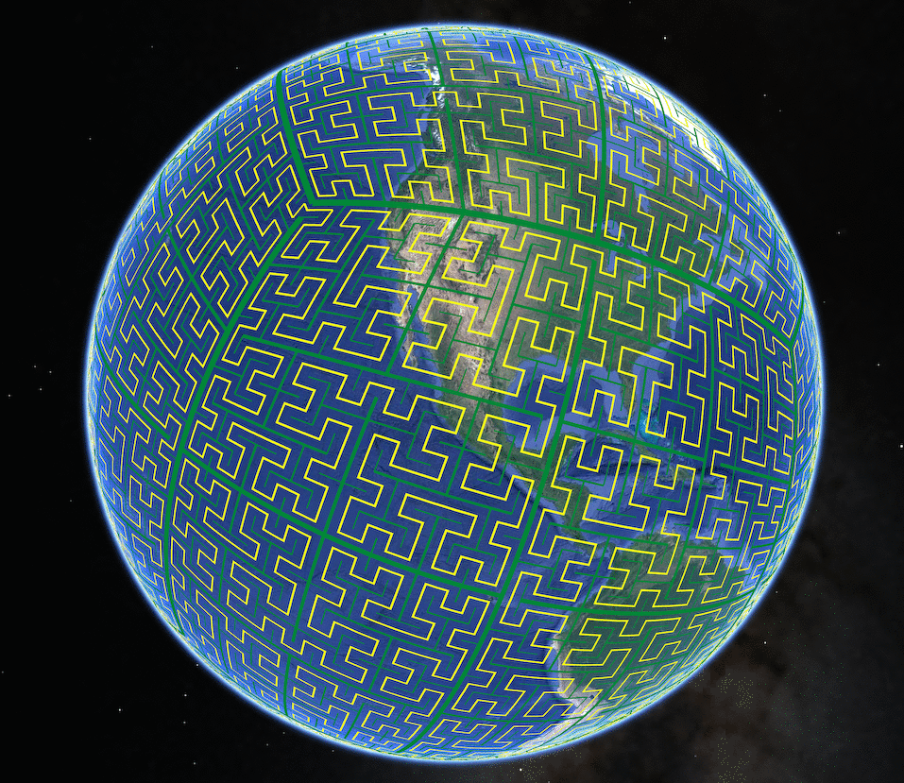
S2 geometry (CATCH v1)
Google's S2 library indexes the sphere with a space-filling (fractal) curve. Benefits:
The (Hilbert) curve maximizes locality.
Cell boundaries are geodesics.
E-W flip from Earth to Celestial Sphere does not affect results.
100x faster than equivalent Hierarchical Triangular Mesh (HTM) indexing.
s2geometry.io
Notes:
Maximize locality: neighboring fields are approximately co-located in the database -> faster disk access.
HEALPix uses spherical harmonics, cell edges are not geodesics
COBE's quadrilateralized spherical cube has a complex projection in order to minimize distortion, subdivision is a quad-tree not a space filling curve, cell edges are not geodesics

Slide 3
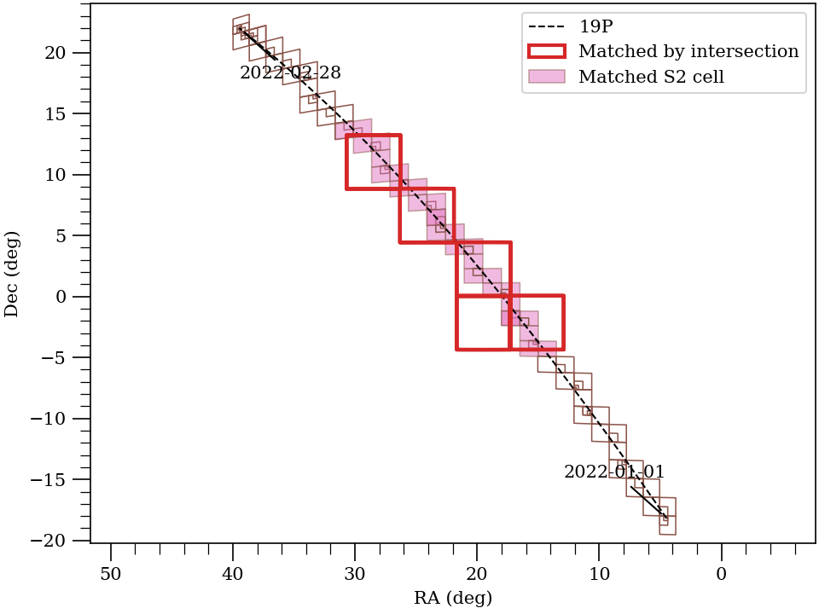
Notes:
Brown outlines are the S2 cells that describe the comet's ephemeris. Pink cells are those that the ephemeris has in common with the matched images outlined in red.

Slide 4
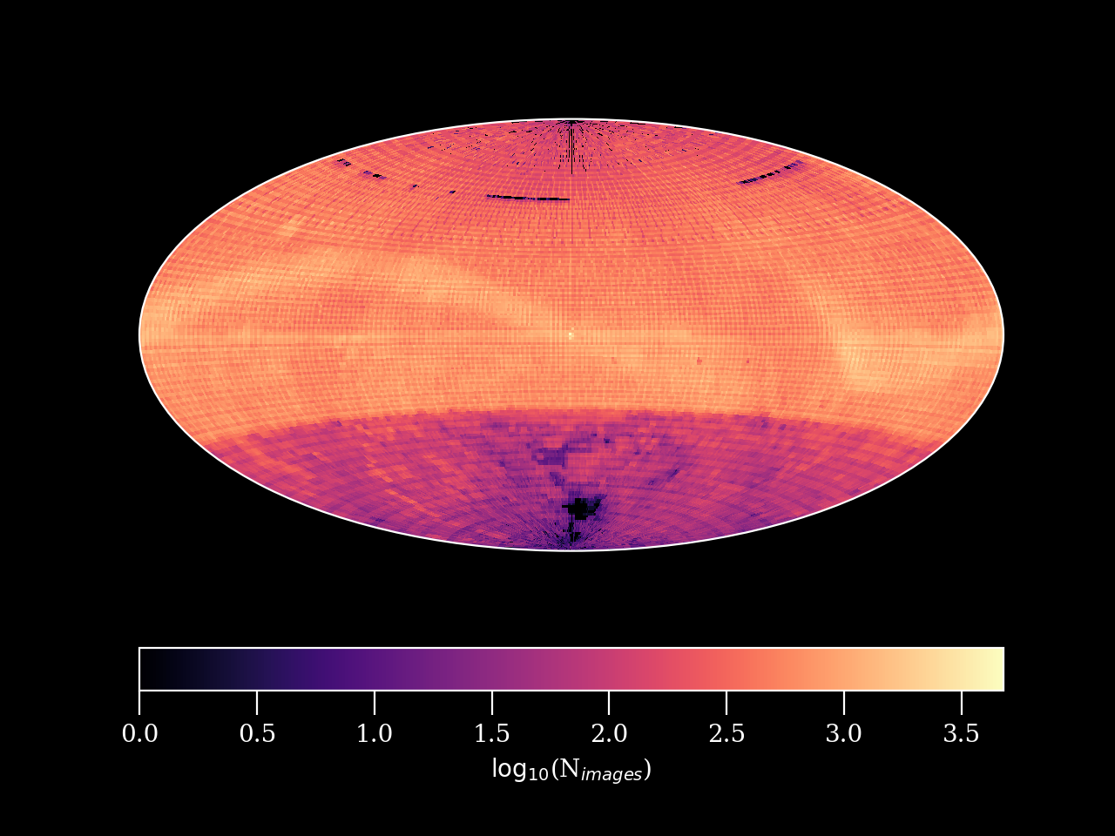
All indexed observations
21,513,410 data products
1996-2022

Slide 5
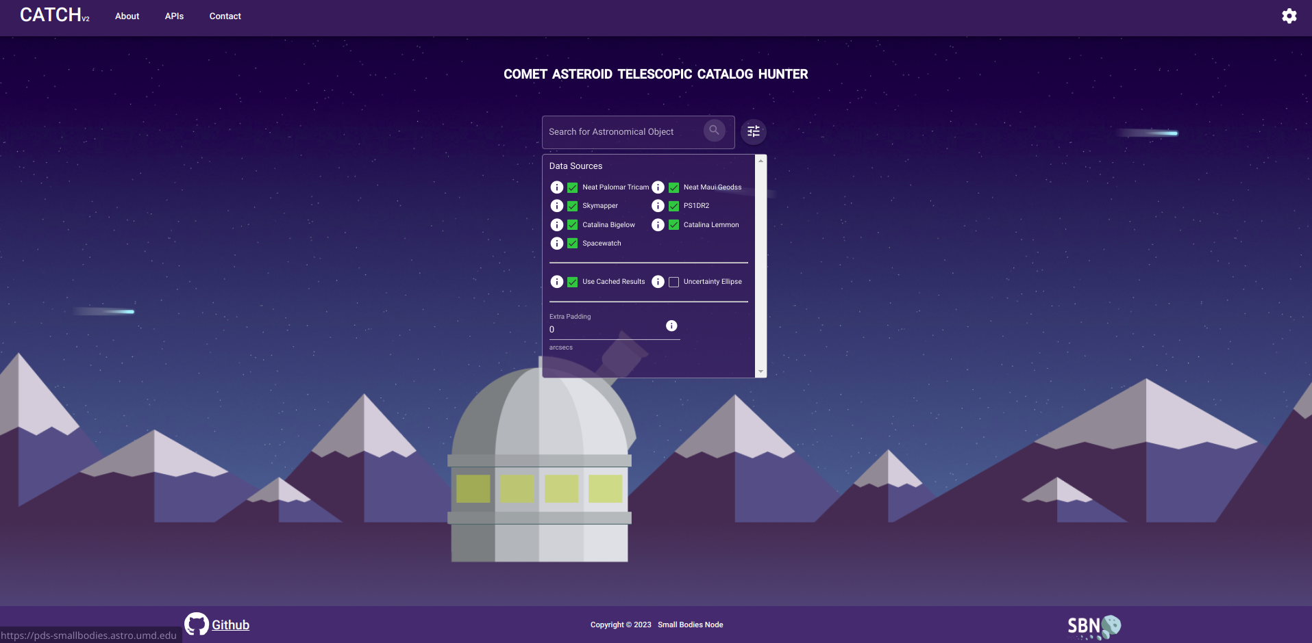

Slide 6
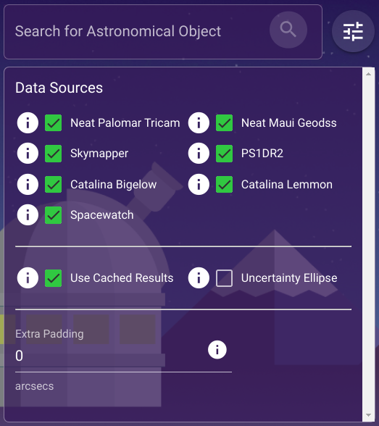

Slide 7
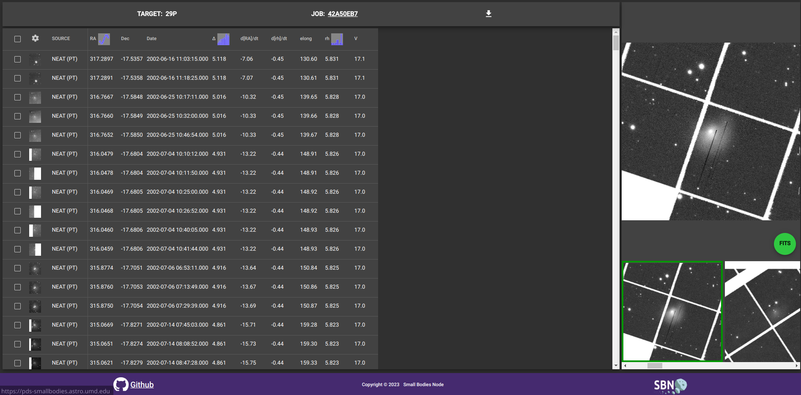

Slide 8
Prototype cloud-deployed cutout service
API
(AWS API Gateway)
[Queue?]
(AWS Simple Queue Service)
Generate cutouts
1. Check for cached data
2. Fetch full-sized data
3. Cutout data
4. Format result
(AWS Lambda)

Slide 9
Planned and possible future work
Add API and front-end support for fixed coordinate searches.
A new backend library (catch v2) uses a combined spatial-temporal index by appending an MJD suffix to the S2 cell ID.
Does this improve performance?
Replace Horizons ephemeris generation with ASSIST?
More surveys!
ATLAS coming soon.
LONEOS data review is this month.
Source catalog search tool?
MPC database integration?
Imagine an overlay of reported observations from the visualized data product.
Requires MPC db API.
(Automatic?) MPC PCCP and NEOCP searches

