Slide 1
MPC Annex @SBN Overview.
SBN Team
October 4, 2023 – San Antonio, TX

Slide 2
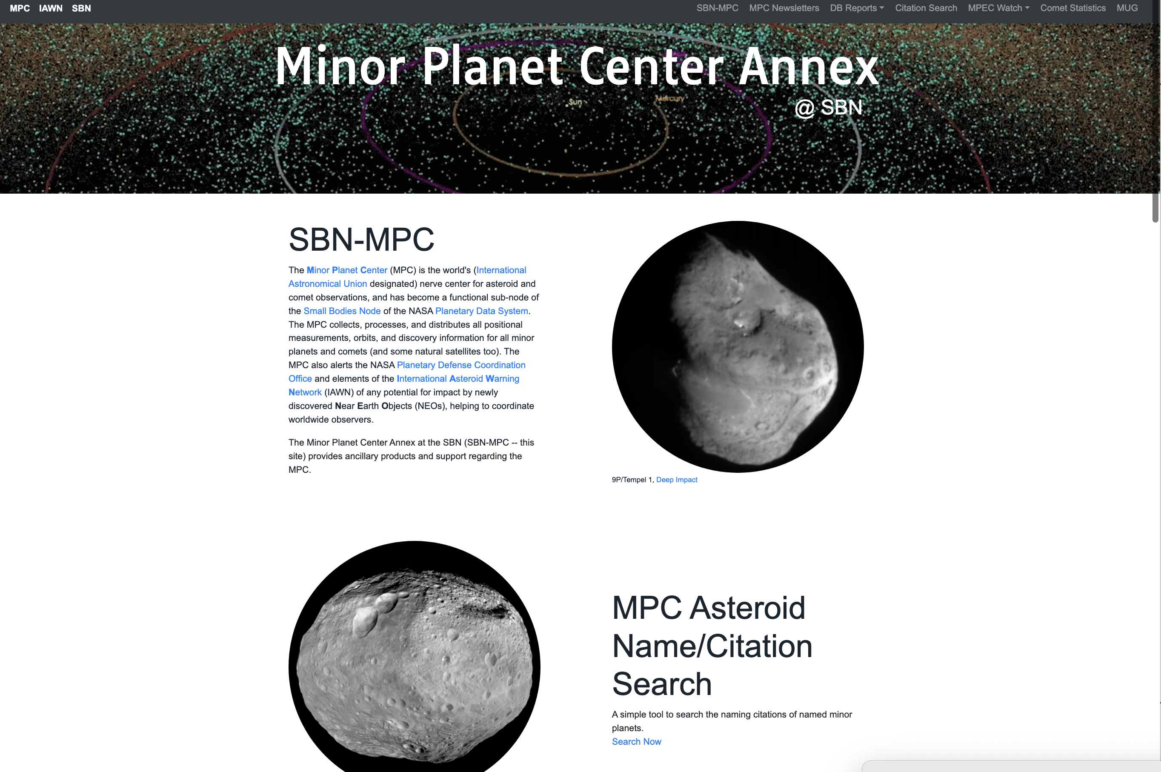
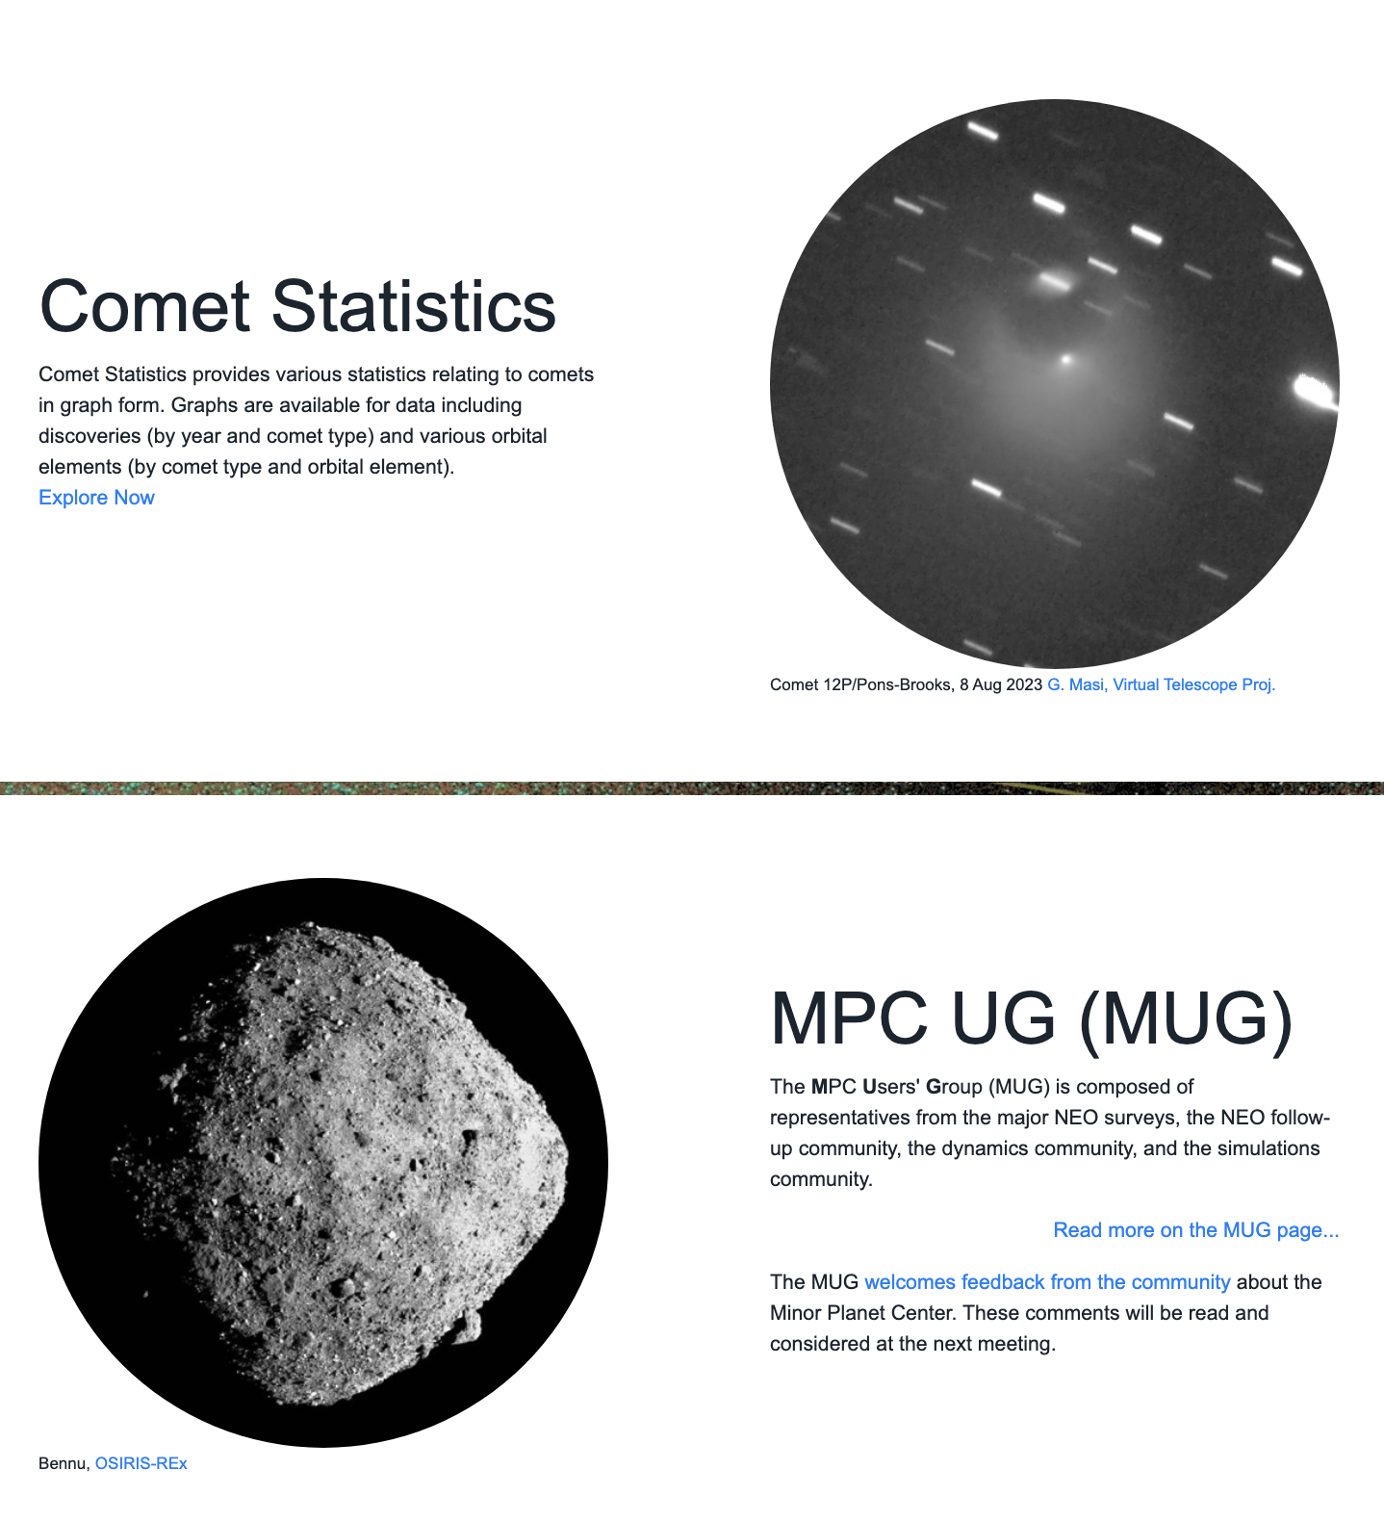
Multiple useful products!

Slide 3
MPC Asteroid Name/Citation Search
A quick lookup tool for asteroid naming history!

Slide 4
Pages that report the health of the MPC DB and Distribution (Plan to retire mpcbeta Postgres database)
mpc_sbn database has ALL tables of mpcbeta database and many other tables.
Distribution of almost all mpc_sbn tables (except observations) is done by a separate SBN publication (sbn146_other_tables_pub) and separate client's subscription.
It’s strongly recommended to switch all client’s software/pipelines from mpcbeta to mpc_sbn (and let SBN know).

Slide 5
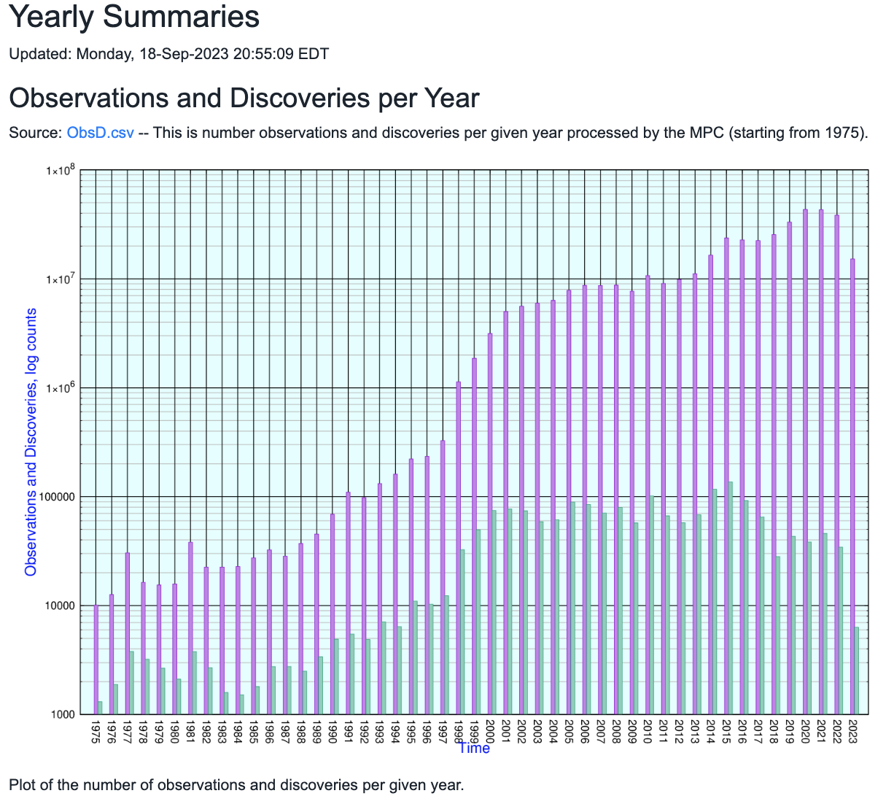
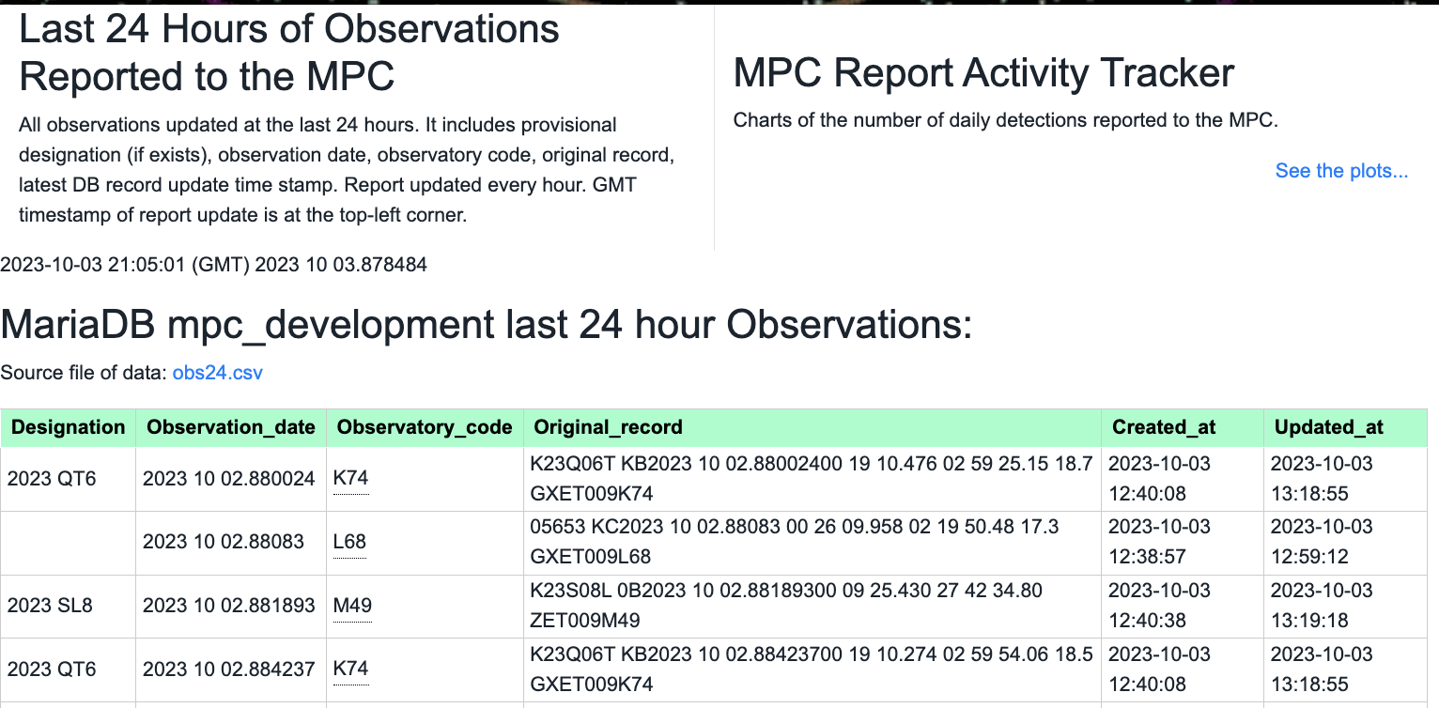
As Well as the most currently reported observations and Annual Counts of Detections and Discoveries

Slide 6
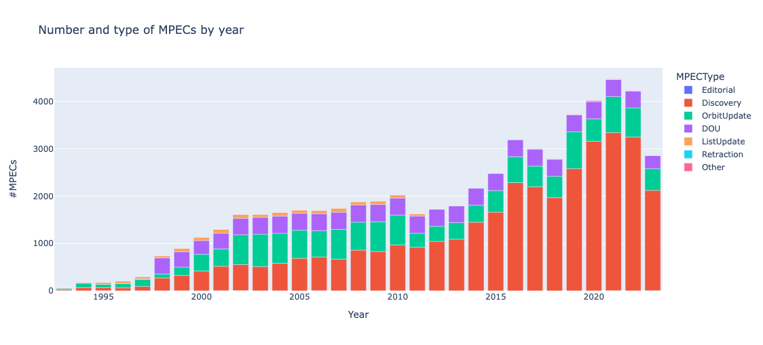
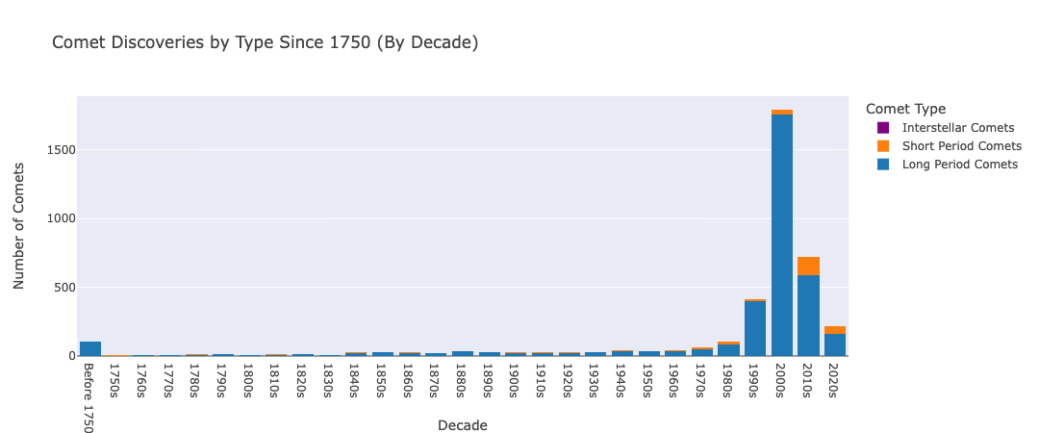
MPEC WATCH:
Developed By Quanzhi Ye, UMD
New Comet Statistics Page
Summarizes Comet Dicsoveries and Observations by type
Notes:
Nominal mission status

Slide 7
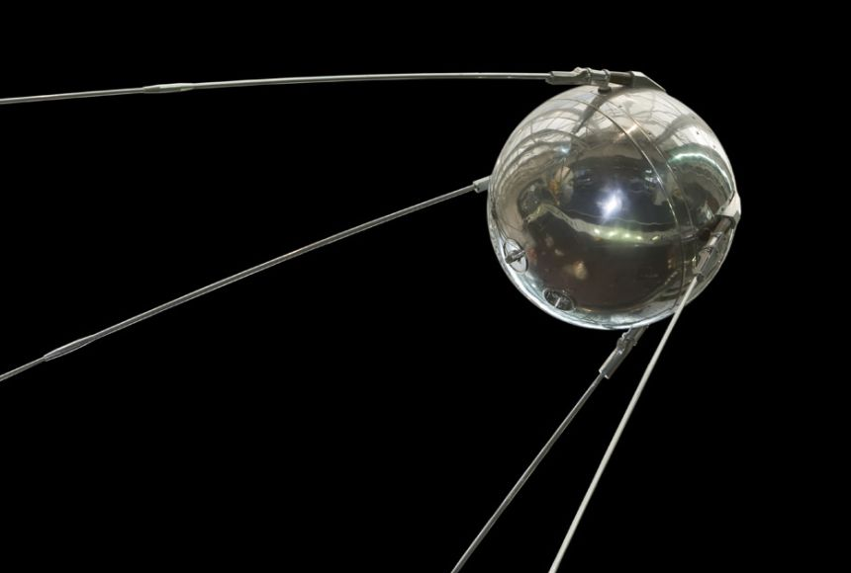
Last but not least… October 4, 1957

