Slide 1
Small Bodies Node User’s Group
Overview
Meeting material: https://sbn-ug.astro.umd.edu/mtg_20231004.shtml

Slide 2
Agenda
Intro – Gerbs Bauer (this presentation)
Highlights (Mission data update) – Ludmilla Kolokolova
Surveys – Eric Palmer
MPC – Federica Spoto
CATCHv2 new features - Mike Kelley
MPC Annex – Andrei Mamoutkine

Slide 3
Agenda
Intro – Gerbs Bauer (this presentation)
Highlights (Mission) – Ludmilla Kolokolova
Surveys – Eric Palmer
MPC – Federica Spoto
CATCHv2 new features - Mike Kelley
MPC Annex – Andrei Mamoutkine
Quanzhi Ye – DPS Urey Prize!
Federica Spoto – EPSC Farinella Prize!

Slide 4
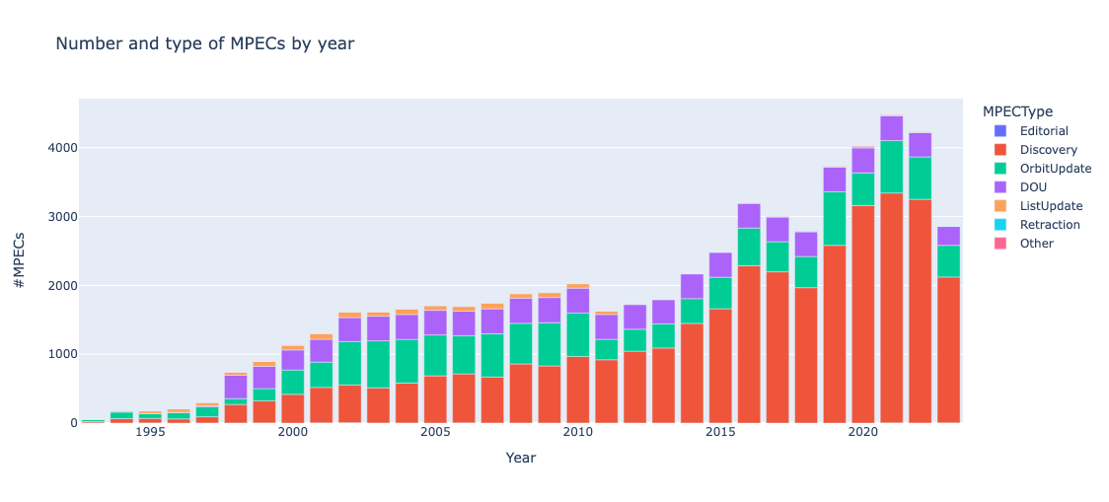
A Multi-product summary statistics tool for MPECs!!
MPEC WATCH:
Developed By Quanzhi Ye, UMD
with UMD intern Taegon Hibbitts
Recently updated
Lists total MPECs by year and by obscode.
Also provides Tables for:
Top MPEC Contributors
Top MPEC-ed Discoverers
Top MPEC-ed Follow-up Observatories
Top MPEC-ed First Follow-up Observatories
Top MPEC-ed Precoverers
... Based on last year, last 5 years, and all time.
Notes:
Nominal mission status

Slide 5
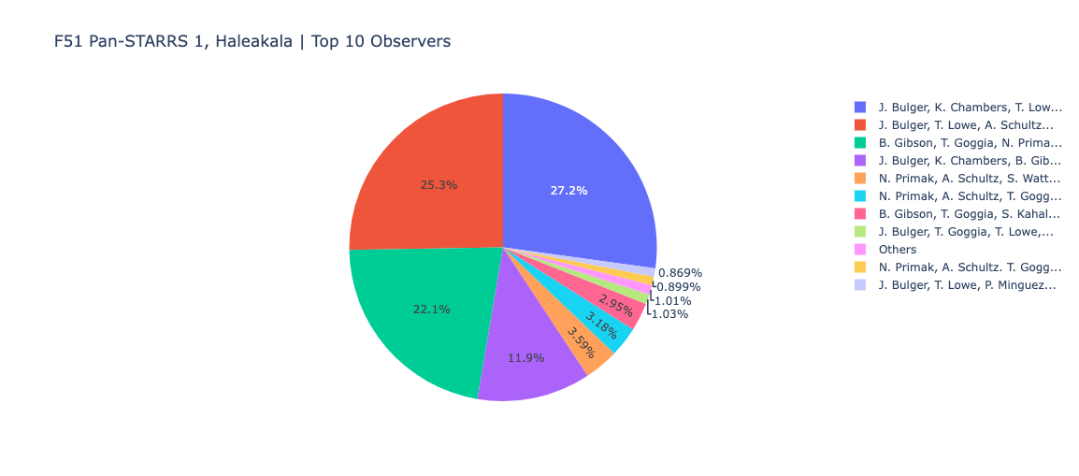
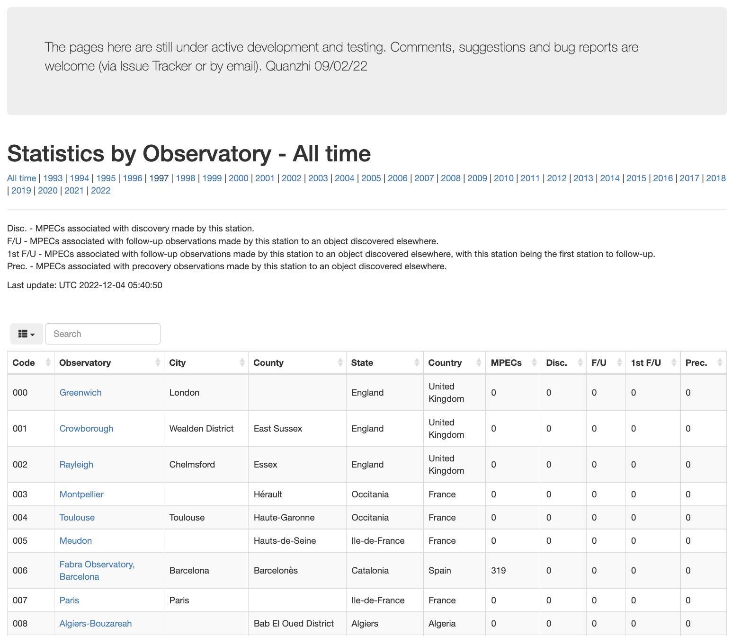
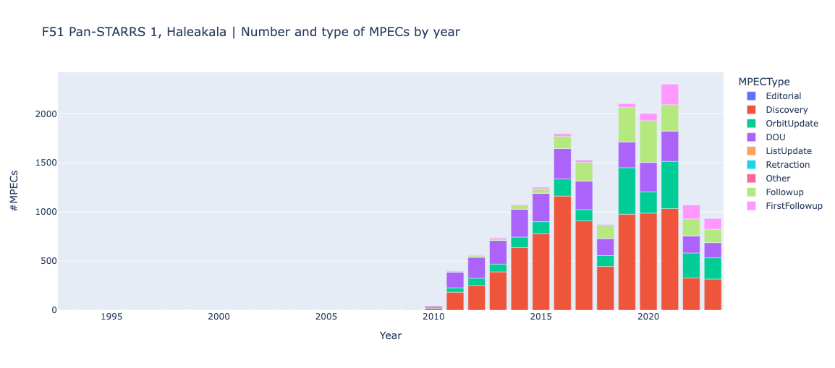
OBSCOD data (Quanzhi Ye and intern Taegon Hibbitts)
OBSCOD Table summary.
Observatory-specific break-down, and a machine readable table summary available for download.
NEW!! – A Full inventory of and Direct links to MPECs as well as links to CATCH
MPEC WATCH:
Notes:
Nominal mission status

Slide 6
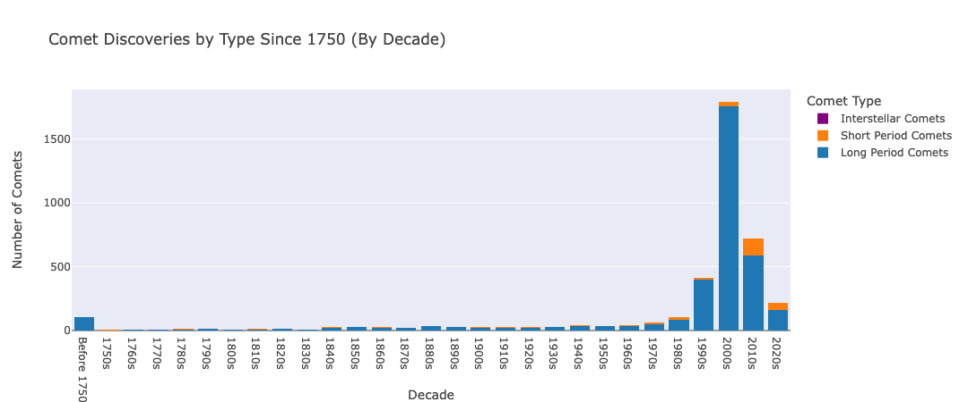
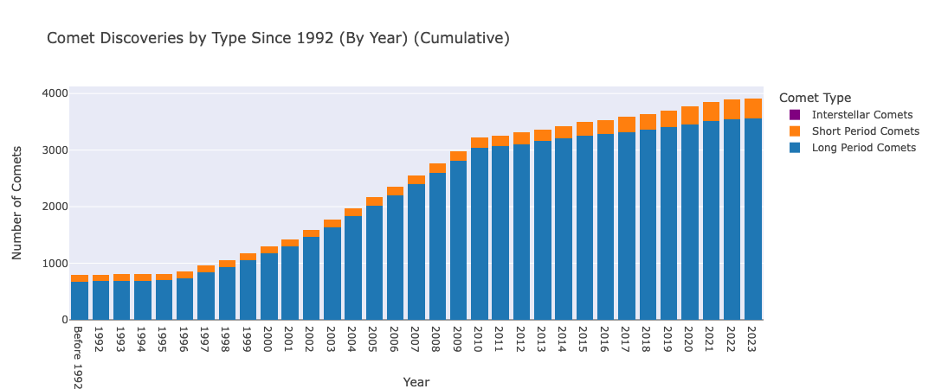
Comet Statistics Page
Summarizes Comet Dicsoveries and Observations by type
Dev. By UMD Intern Pete Smith
Notes:
Nominal mission status

Slide 7
Radar Archiving:
Radar Archiving Tag-up Meetings – Beatrice Mueller
Review Radar Archiving progress
Discuss topics of interest to archiving
Spring and Fall
Notes:
Nominal mission status

Slide 8
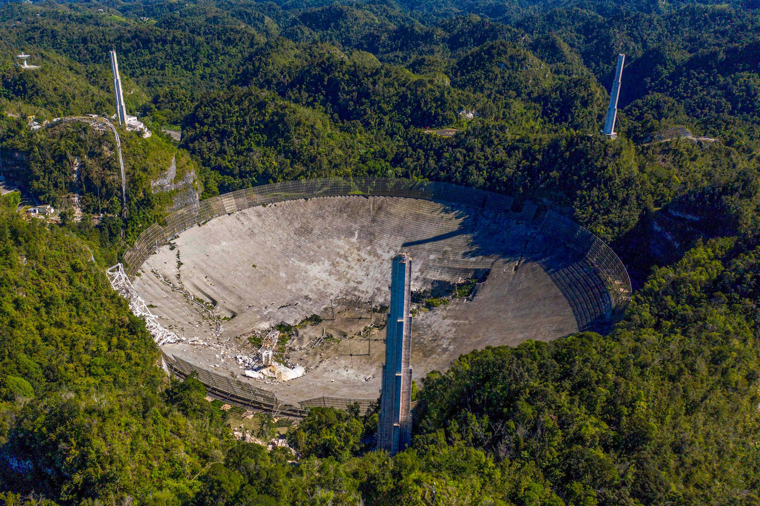
Radar Archiving:
Pre-Archiving Arecibo Data Capture
Following Arecibo’s catastrophic collapse in 2020, storage and preservation of the data has become a concern.
The Small Bodies Assessment Group, SBAG, issued a finding that voiced concern about loss of data before archiving.
SBN has copied the data and commenced with storing a copy at the NSSDCA.
Notes:
Nominal mission status

Slide 9
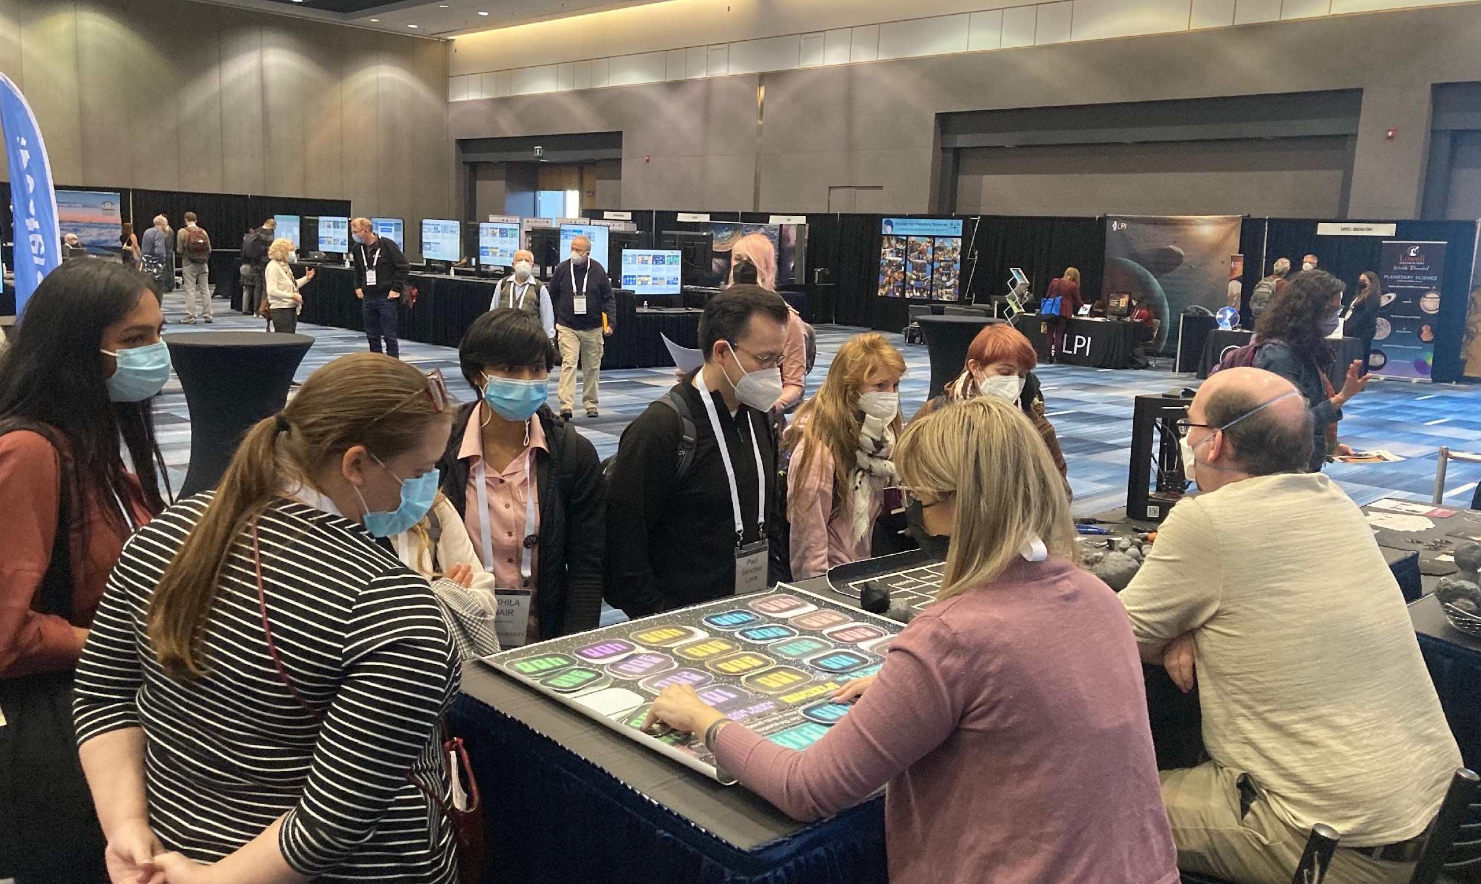
SBN Meeting Highlights:
A Lot of Meetings:
SBN participated on PDC 2023 OC, presented & chaired at meeting.
Organized and helped run the MUG meeting June 7-8 at CfA; multiple SBN presentations.
SBN (Raugh) supported the IVOA Solar System interop in Bologna in May.
Flagstaff:
ACM – SBN presented and active at the meetings. ACM lunch meeting, sidebar conversations regarding MPC, SBN missions.
PDW – “ “
IPDA held June 29-30, 2023, immediately following PDW, at USGS Flagstaff (Thank you Imaging/Cartography!).
Notes:
Nominal mission status

Slide 10
SBN Meeting Highlights:
Recently…
SBAG – SBN attended and presented.
UMD On-campus venue for July PDS MC F2F.
A. Raugh supporting Webinar series Steve Crawford is organizing to address issues of FAIR data access and Open Science.
DPS Booth planning … Many thanks to Anne Raugh and Kristina Lopez for generating material, and Tom Morgan and at the PO for organizing logistics, and Ludmilla Kolokolova for planning the SmUG.
ADASS Organizing – Thanks to Asteroids Sub-node at PSI for helping to Organize the conference! Bea Mueller serves on the LOC.
IPDA (Bauer Chair) and IVOA (A. Raugh Sol. Sys. Interop chair) support.
Additional meeting support regularly provided by Eric Palmer (PI Asteroids Subnode), and regular booth support from Ben Hirsch as well as Sheri Loftin (PO).
Notes:
Nominal mission status

