Slide 1
Status of SBN’s Ground-based Surveys Archive
DPS Meeting 2023
Eric E. Palmer

Slide 2
Catalina Sky Survey
Active survey
4-5 telescopes each clear night, ~7 TB/month
Established a pipeline to process current and historical data
Current: Was active Jan 20, 2022 until Monsoons (for software upgrade)
Receive 100-200 MB/day
Historical: Jan 2020 to present
Can process 50 GB/day
Paused since monsoons to upgrade software
Almost ready - Internal review
Archived: 111 TB out of 377 TB
On hold
PSI had major IT failure. All data is safe, but equipment used for processing was lost

Slide 3
Catalina Sky Survey - Future
Kitt Peak 90" Bok Telescope (ongoing CSS observations)
May 2023
Siding Spring 0.5m Uppsala Schmidt (operated by CSS 2003-2013)
August 2023
Mt. Lemmon 0.8m Schulman telescope
Nov. 2023; pending telescope and instrument improvements
CSS may add other telescopes

Slide 4
NEAT - Near Earth Asteroid Tracking
Background
A collaborative effort with the United States Air Force (USAF)
December 1995 - 2007
Previously Archived one portion (2TB)
Currently working on the remainder (NEAT/QUEST)
Volume: 50 TB
Maui MSS, Part 3 of Palomar Tri-Cam, Palomar QUESET
Review Status: 4th volume received and 3 passed validation
8TB disks sent from JPL regularly. Expecting 3-4 more deliveries.

Slide 5
Spacewatch
Description:
0.9m Mosaic Camera Survey began in March 2003 - 2016
Goal of discovering near-Earth asteroids by surveying the sky mainly within 15 degrees of the ecliptic.
Archived
Mosaic data - Complete: 30 TB
In progress
1.8 m follow-up — 2011-2022
Sample internal reviewed: 12 TB
Drift scans: < 1TB

Slide 6
LONEOS
The LONEOS data have been recovered from disk storage and magnetic tape
Dates: 1998-2011
Currently: Available as-is.
Available at SBN, see the readme.txt file for more details.
R&A has been funded through a NASA YORPD 2021 grant
PI: Ed Tedesco
Volume: 13 TB
Status
Review of a sample held January 4
Delta review scheduled for October 18 (includes additional data)
When the year is finished, no more work will be done

Slide 7
Data Storage
Prime
All data is “on-line” and directly accessible
No cost or download limits
Backup copy (per requirements)
Stored in “Glacier” with Amazon Web Services
This has a cost for egress
Only for repopulating primary system
Long term copy
NSSDCA - NASA’s long term archive at Goddard Spaceflight Center

Slide 8
Radar
Arecibo Doppler Radar Spectra sample data review held February 8
In liens resolution (includes all the data)
Raw Goldstone SSR Radar Data review held February 10
In liens resolution, delta review required

Slide 9
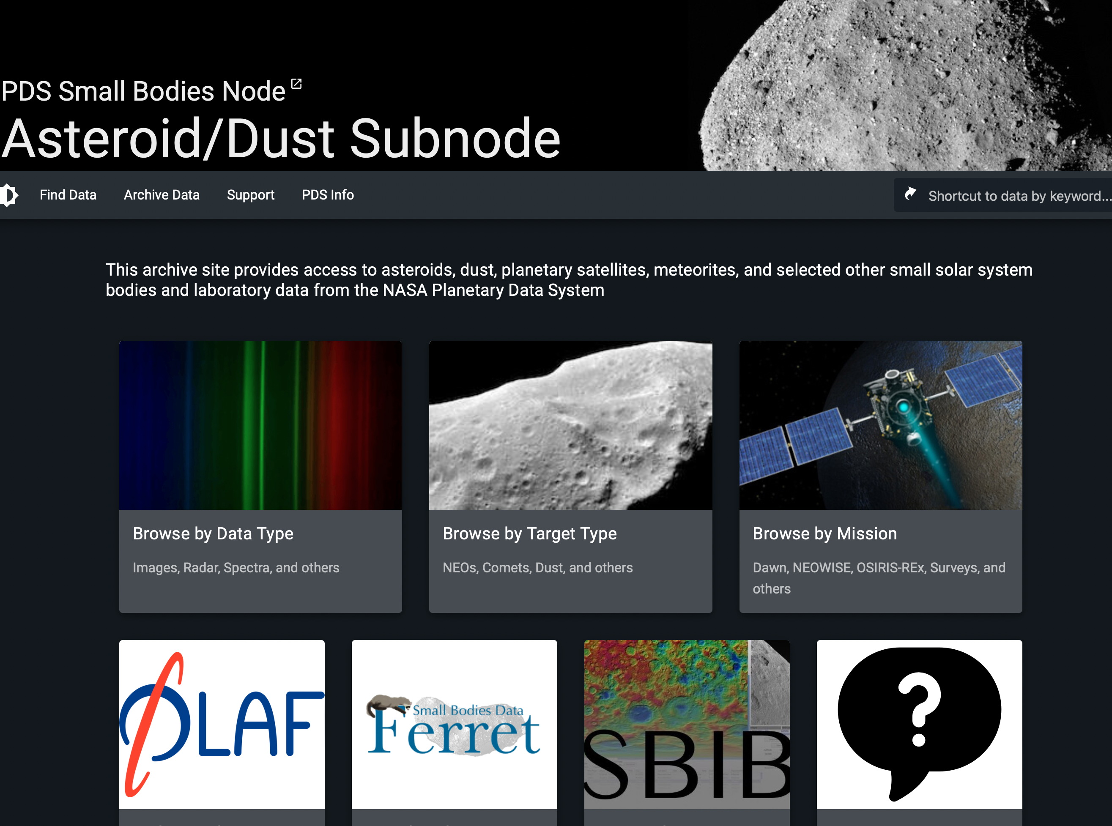
Web Access
CATCH is primary tool
https://catch.astro.umd.edu
Web:
https://sbn.psi.edu/pds/archive/surveys.html

Slide 10
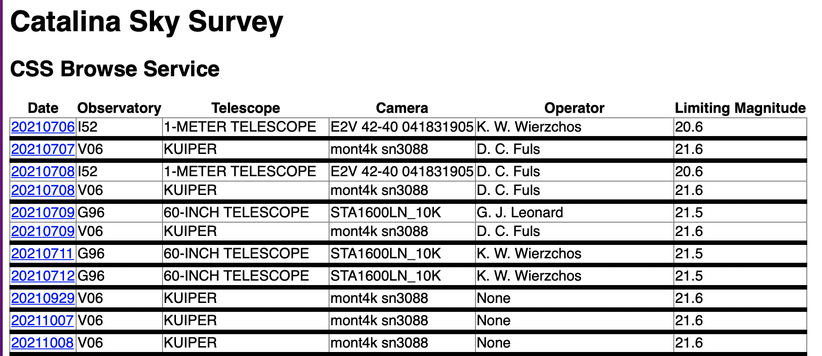
Web Access
Basic web browse capability
https://cssdb.psi.edu/
Directly pulled from submitted data
Feedback - Is this a requirement? Consistent?

Slide 11
