Slide 1

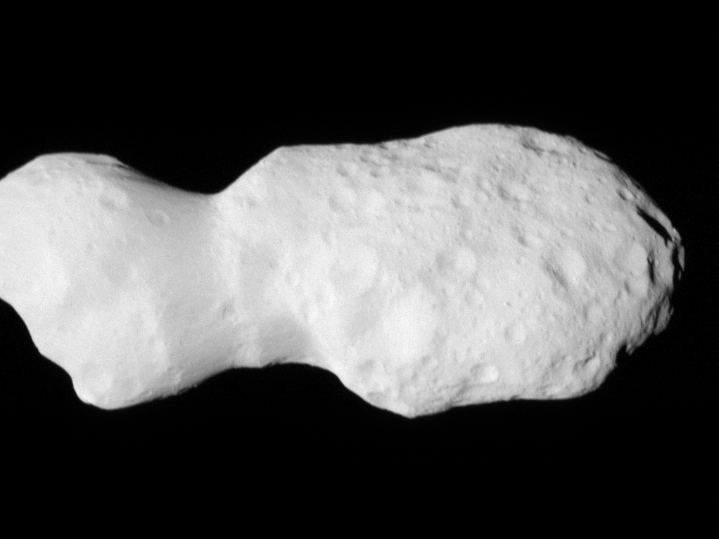



2025 SmUG Update
The NASA Planetary Data System’s Small Bodies Node –
Overview & Services
DonaldJohanson L’LORRI data.
Authors: The SBN Team.

Slide 2
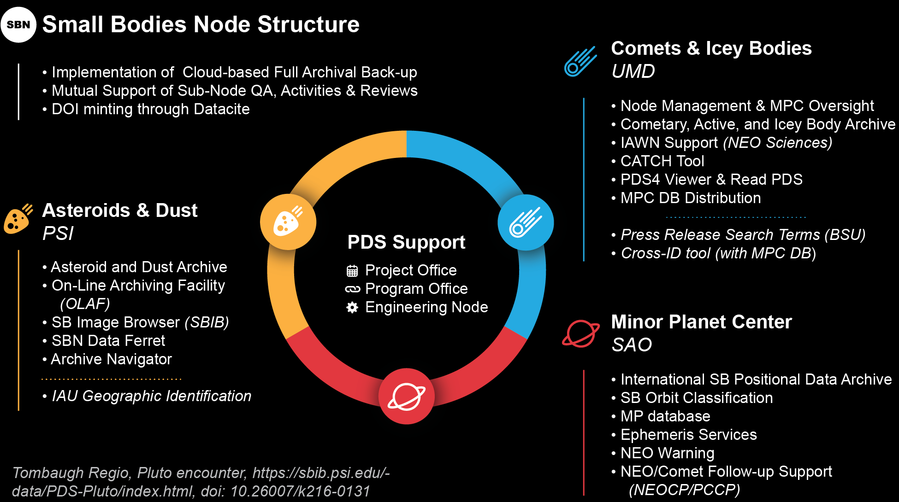
Comets & Icy Bodies
y

Slide 3
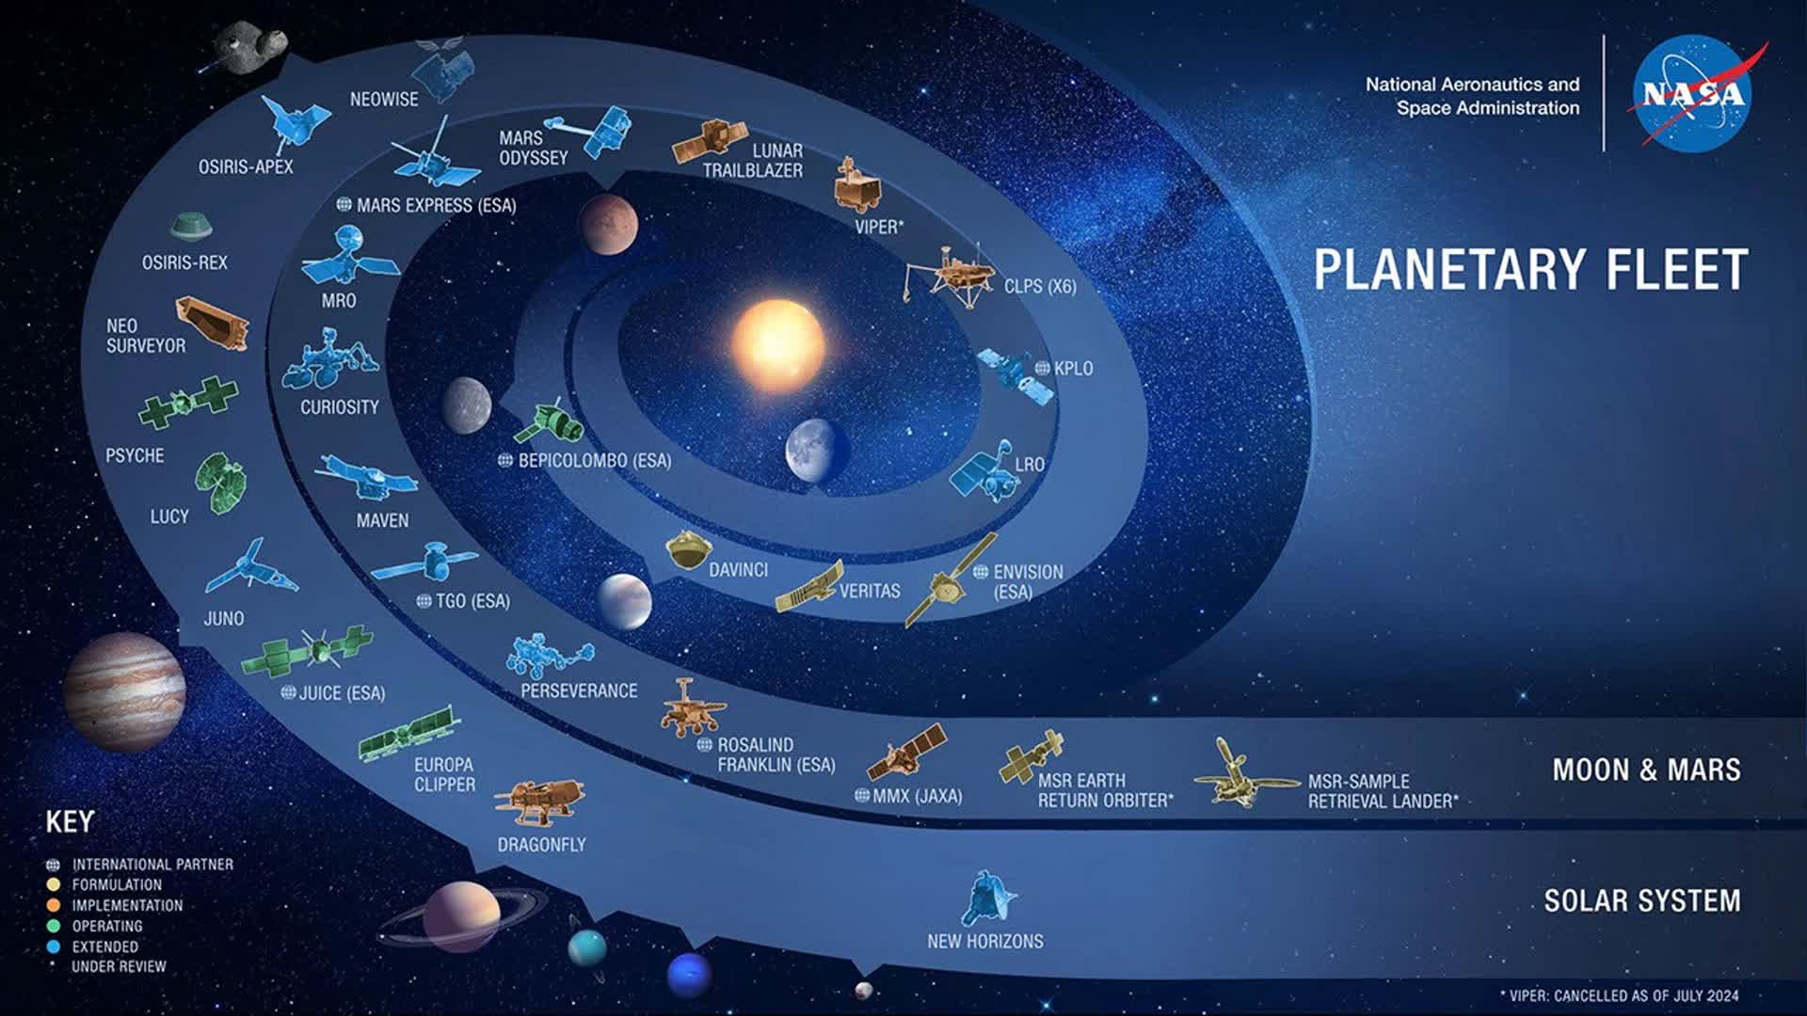
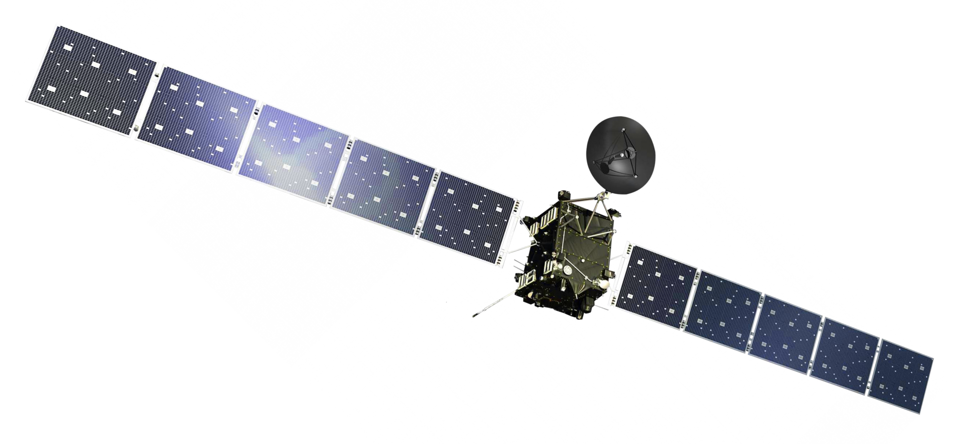
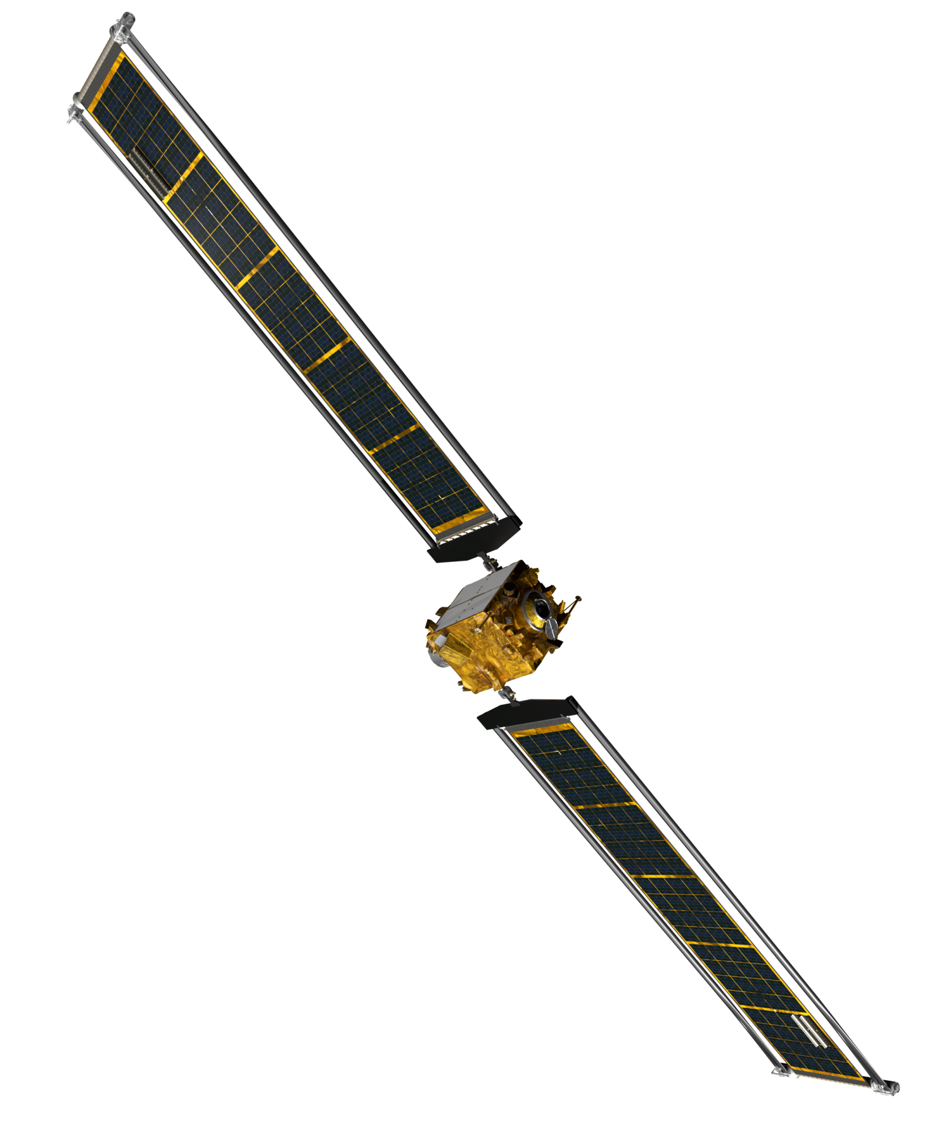
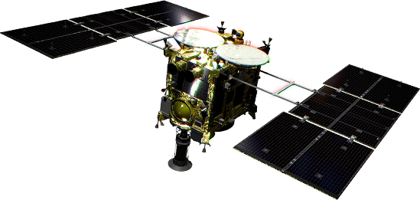
Rosetta
DART
Hayabusa2

Slide 4
SmUG Presentations
Overview & Services [this presentation]
Datasets (Reviews, Missions, R&A, PDS4 Migration)
Meeting Support
MPC Update
SmUG Discussion / Q and A

Slide 5
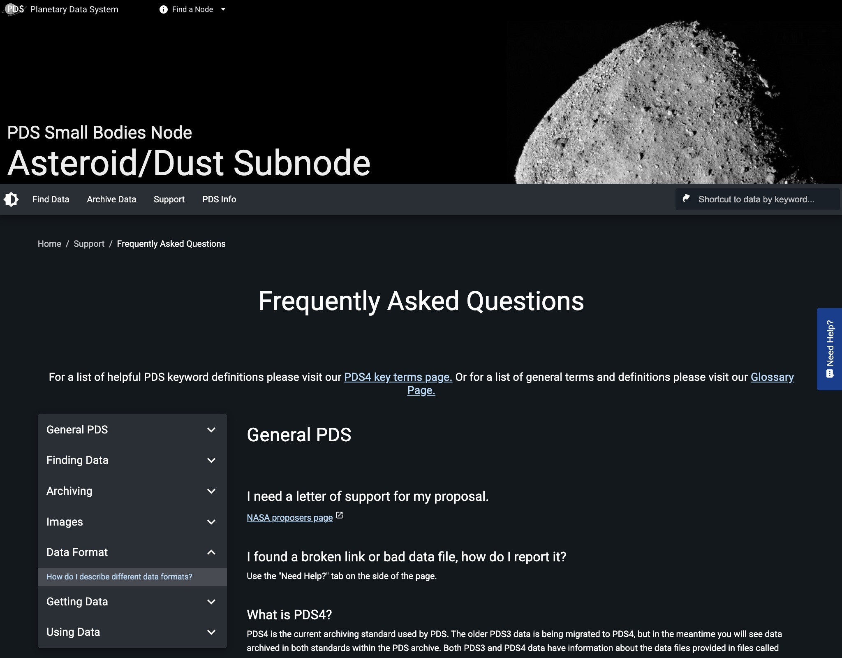
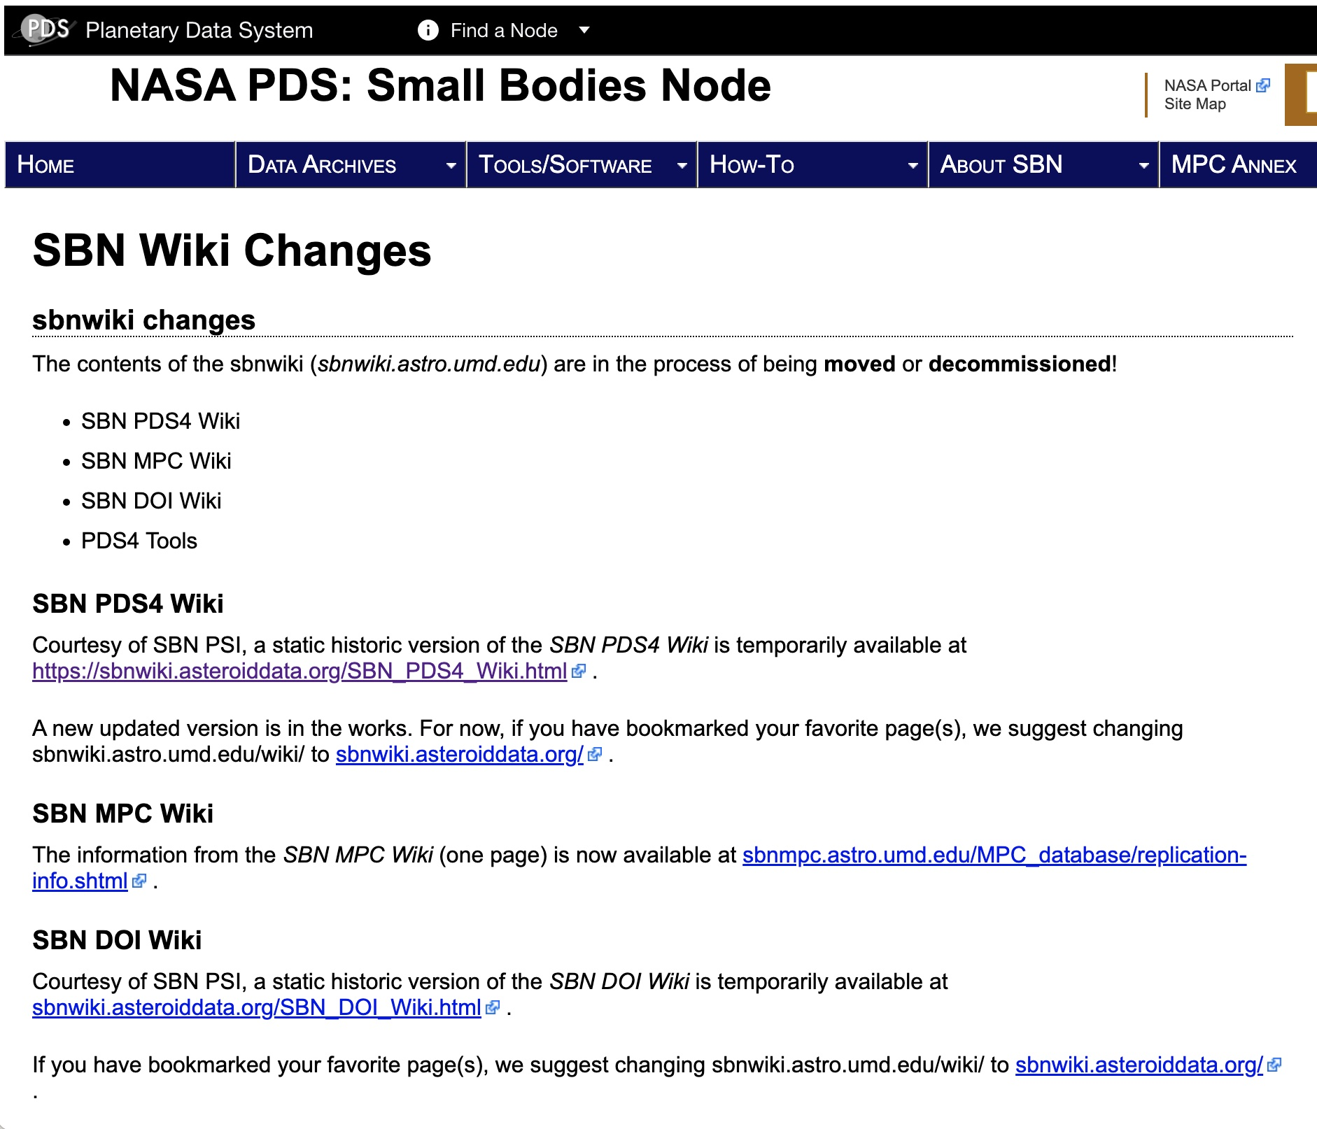
Information Services

Slide 6
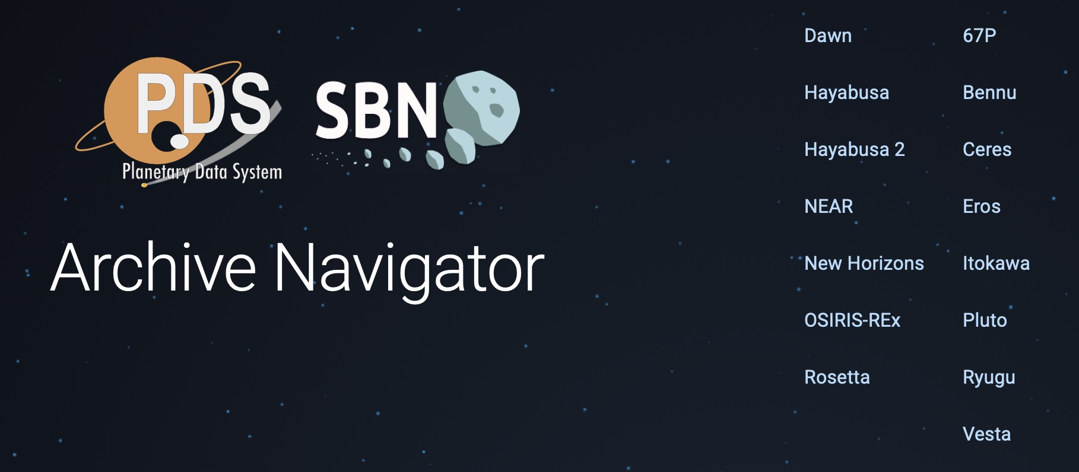
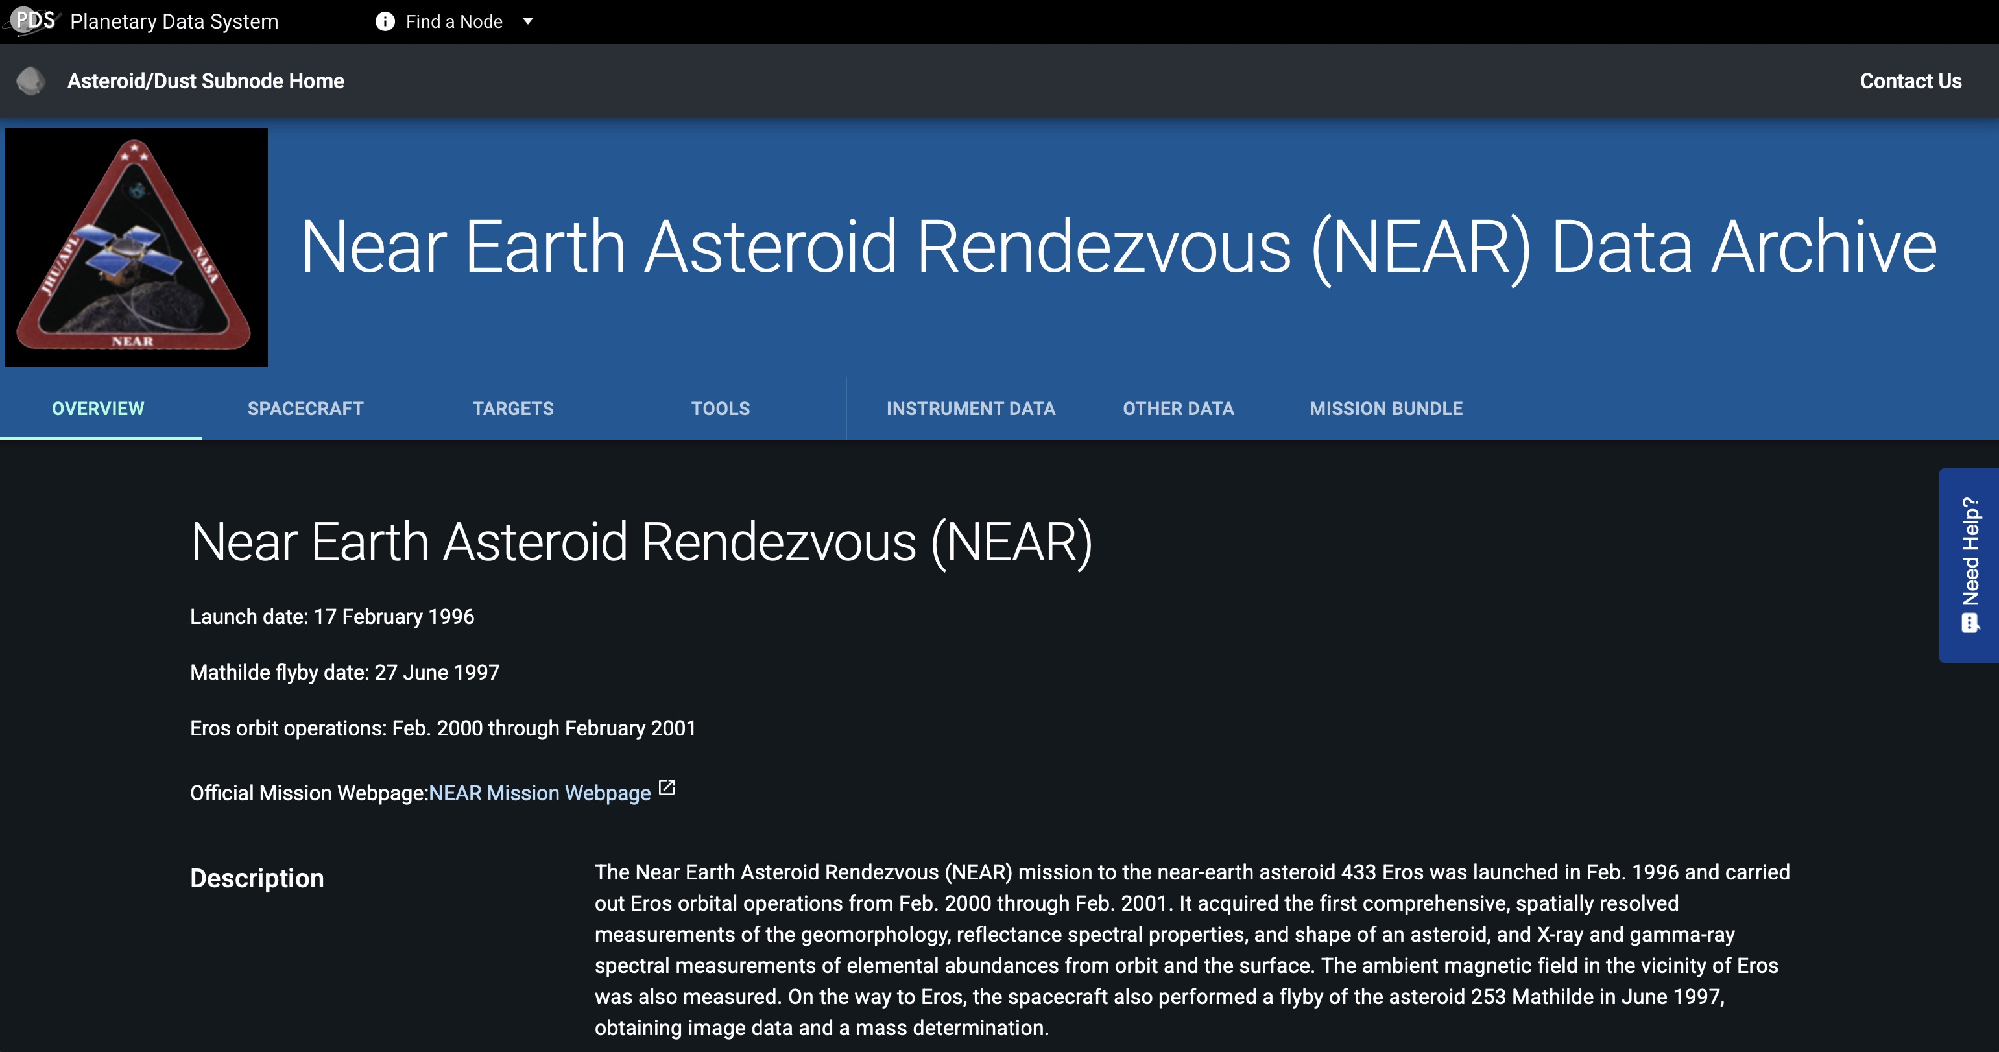
Information Services

Slide 7
MPCDB Distribution & Testing
Through AWS Cloud
MPCDB to EC2
EC2 to Aurora and to clients…

Slide 8
“Natural” Stress Test of MPC DB Distribution
Object of update: obs_sbn table mpc_sbn db.
Time range: July 23 – August 7, 2025 (16 days)
Number of updated records: ~500M
Number of controlled stops: 4
Number of slots before the test: 16
Number of inactive slots: 3
Number of dropped replication slots: 2
Number of recovered slots: 3
Number of active slots after the test: 15
Maximum sync lagging: 22GB
Maximum WAL-files size: 22GB
* Data for the plot is a courtesy of the MPC.

Slide 9
Current List of Subscribers
Count | Organizations | Replication Slots
1 | Asteroid Institute | 2
2 | Andreas Doppler | 2
3 | ESA (European Space Agency) | 2
4 | JPL (Jet Propulsion Lab) | 2
5 | Tyler Linder | 2
6 | MPC loop | 2
7 | Peter Van Wylen | 2
8 | MAQI (SBN open query tool) | 2
9 | CalTech | 2
10 | ODP (Observatorie de Paris, France) | 2
11 | PanSTARRS | 2
12 | CSS (Catalina Sky Survey) | 2
13 | Vera Rubin observatory | 2
14 | Rubin USDF (US Data Facility) | 2
15 | PMO (Purple Mountain Observatory, China) | 2
16 | LSST Brazil (Large Synoptic Survey Telescope) | 2
17 | SDS (Space Dynamics Services, Italy) | 2
 | Total | 34
Notes:
Tyler and MPC_loop switched their subscriptions from Musforti to Aurora cluster.

Slide 10
In Brief:
MAQI – The MPC DB Open Query Tool
https://maqi.astro.umd.edu/
Capabilities:
People want to do SQL
(Blackbox: we’ll give you a postgresql host, read-only user & password)
API
GUI interface
Limitations:
Limited short queries
Won’t let user make infinite queries
Won’t let user write to DB
Questions for the SmUG:
Is the time-out too strict?
What is a common Query example you’d like to know how to do?

Slide 11
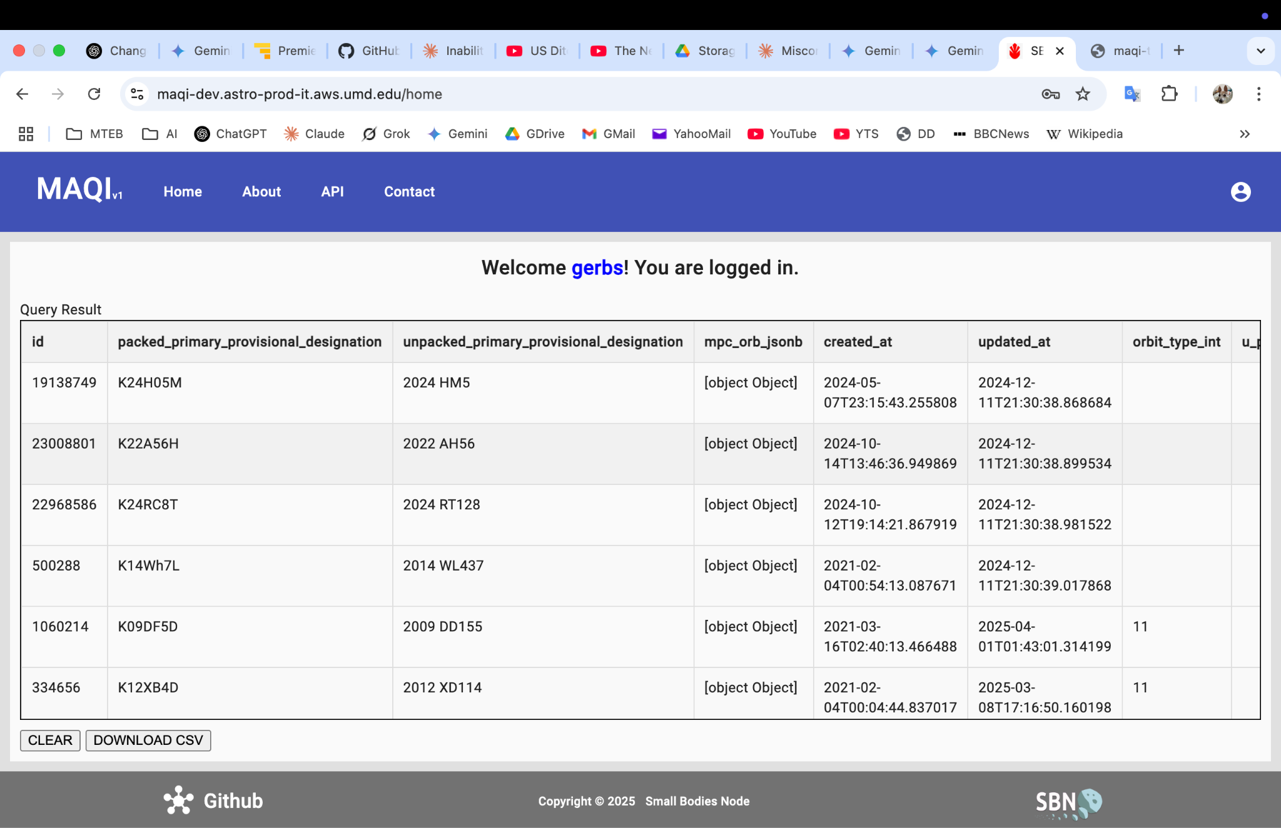
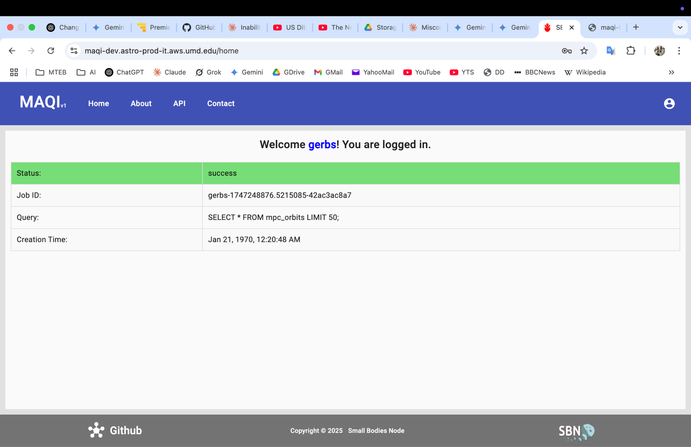
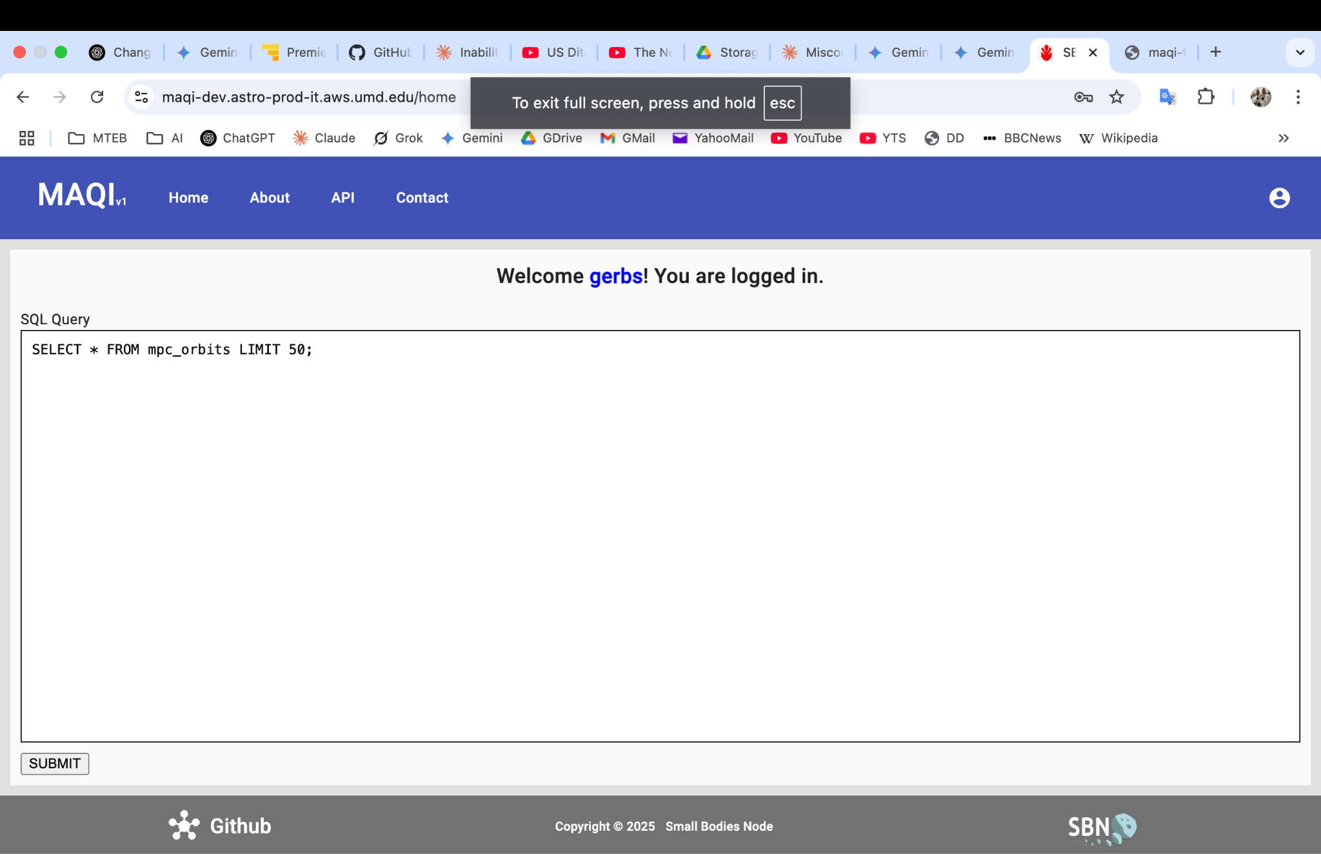
MAQI – The MPC DB Open Query Tool

Slide 12
MAQI – The MPC DB Open Query Tool

Slide 13
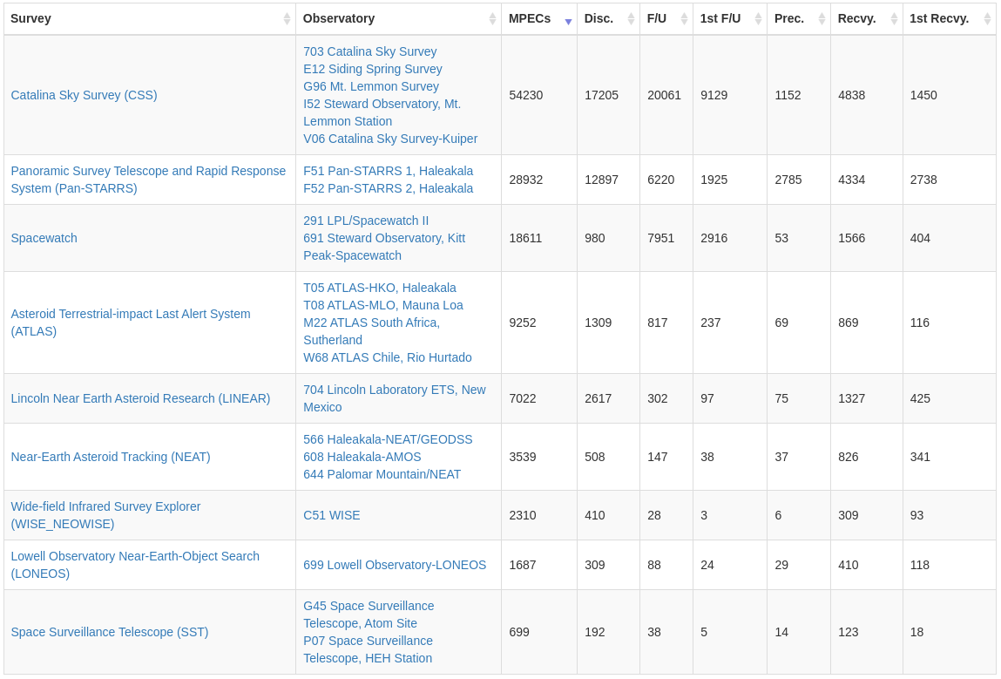
MPEC Watch – Recent Upgrades
New (since Oct 2024):
Survey tally pages
Stats of individual observers/measurers
Fixing typos and spelling errors (in MPEC Watch database; not at MPC)
Being working on:
A new table that contains object info (will support observatory-object query)

Slide 14
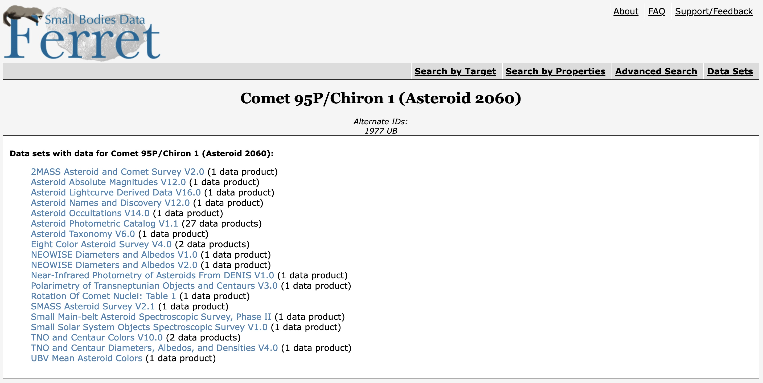
Data Access

Slide 15
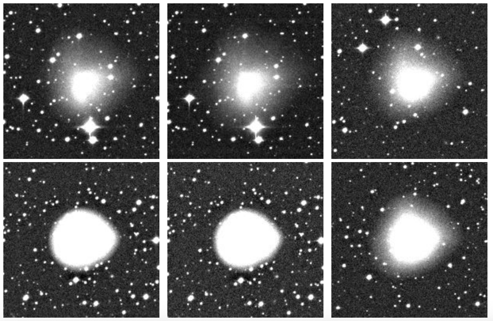
Surveys
SBN Archive Surveys: Precovery & Characterization Resource Base
CSS Deliveries continue
Regular Delivery to NASA managed Cloud
238 TB Archived (over 4K telescope nights)
Included in CATCH with full-frame links
ATLAS deliveries continue, 888TB (2K nights) with access through CATCH.
Possibly deliveries to NSSDCA by end of year
Also have Spacewatch (32TB), NEAT (20TB), and LONEOS (13TB). NEAT Quest (50TB) is in lien correction.
~ 1.2 PB in Survey Data alone!
CSS cut out server test, Courtesy Kelley and Darg (SBN/Comets)

Slide 16
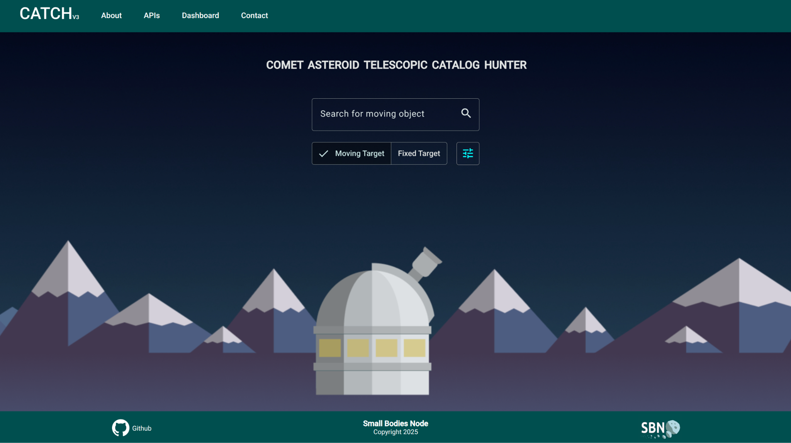

Slide 17
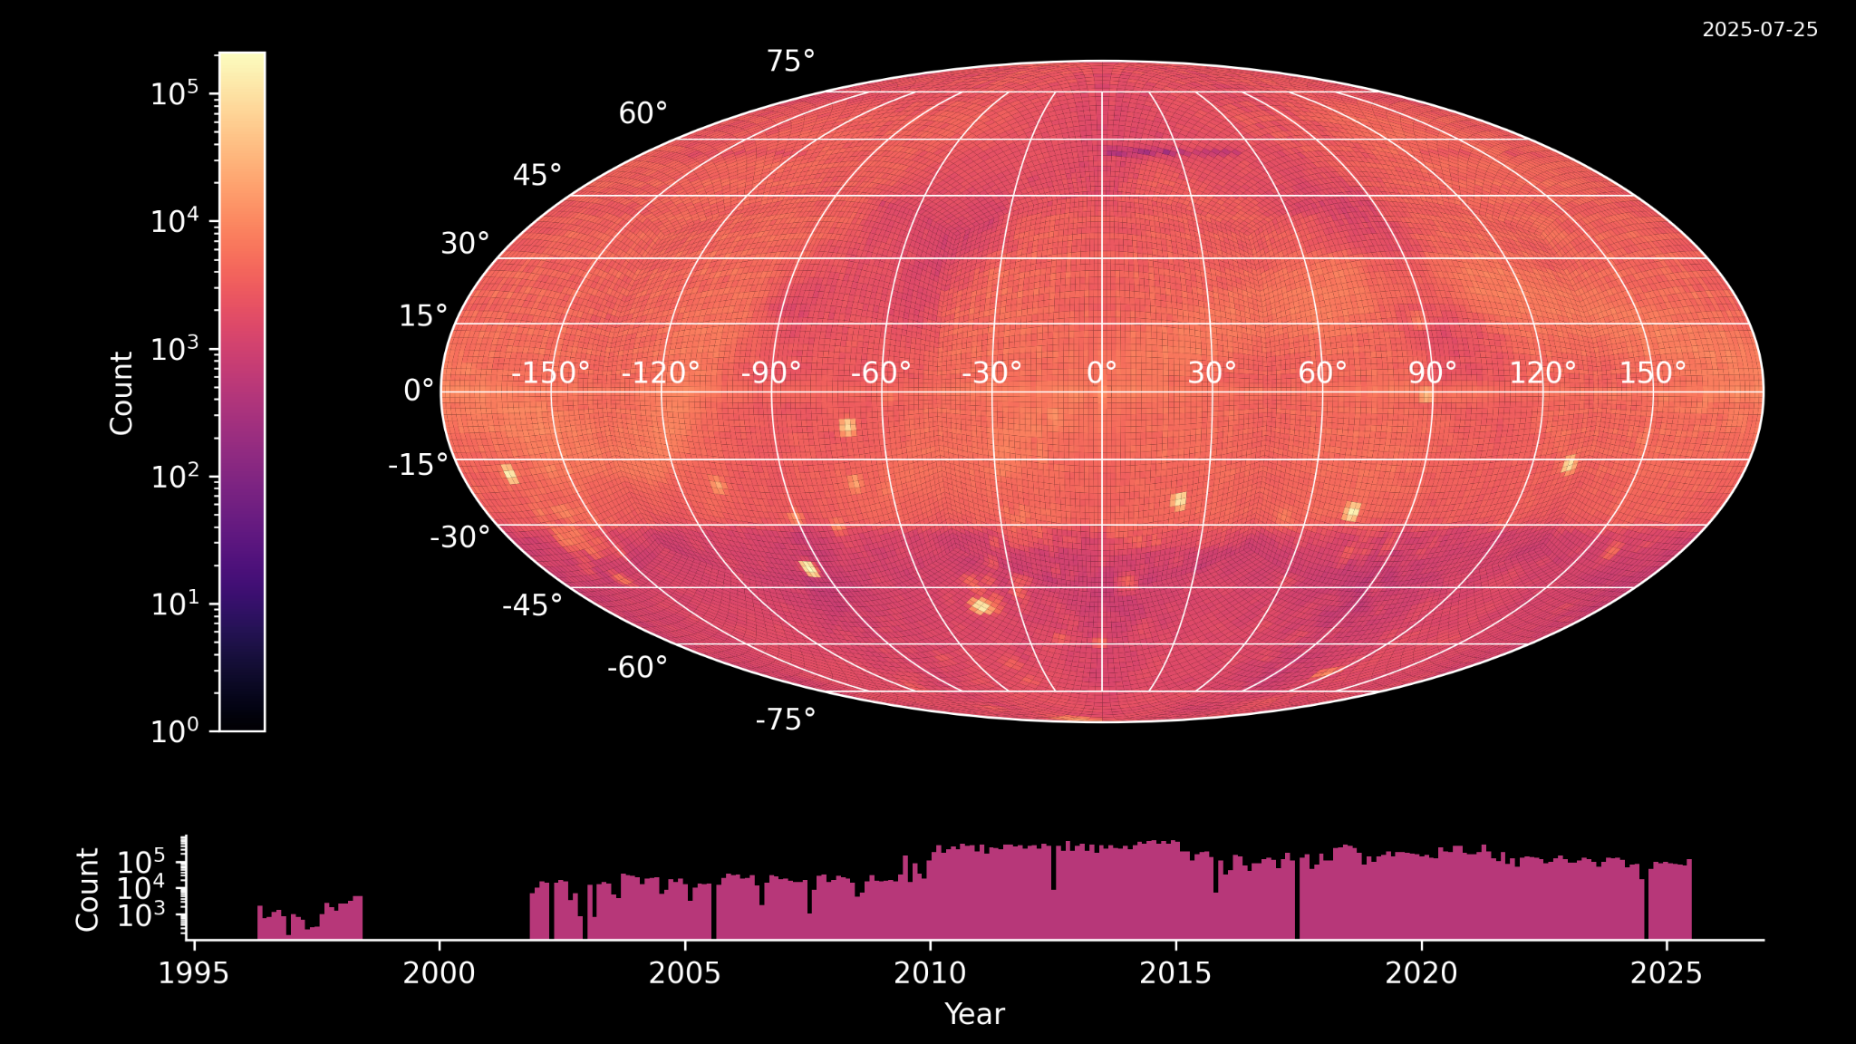
38 million data products indexed by CATCH
2025 July 25

Slide 18
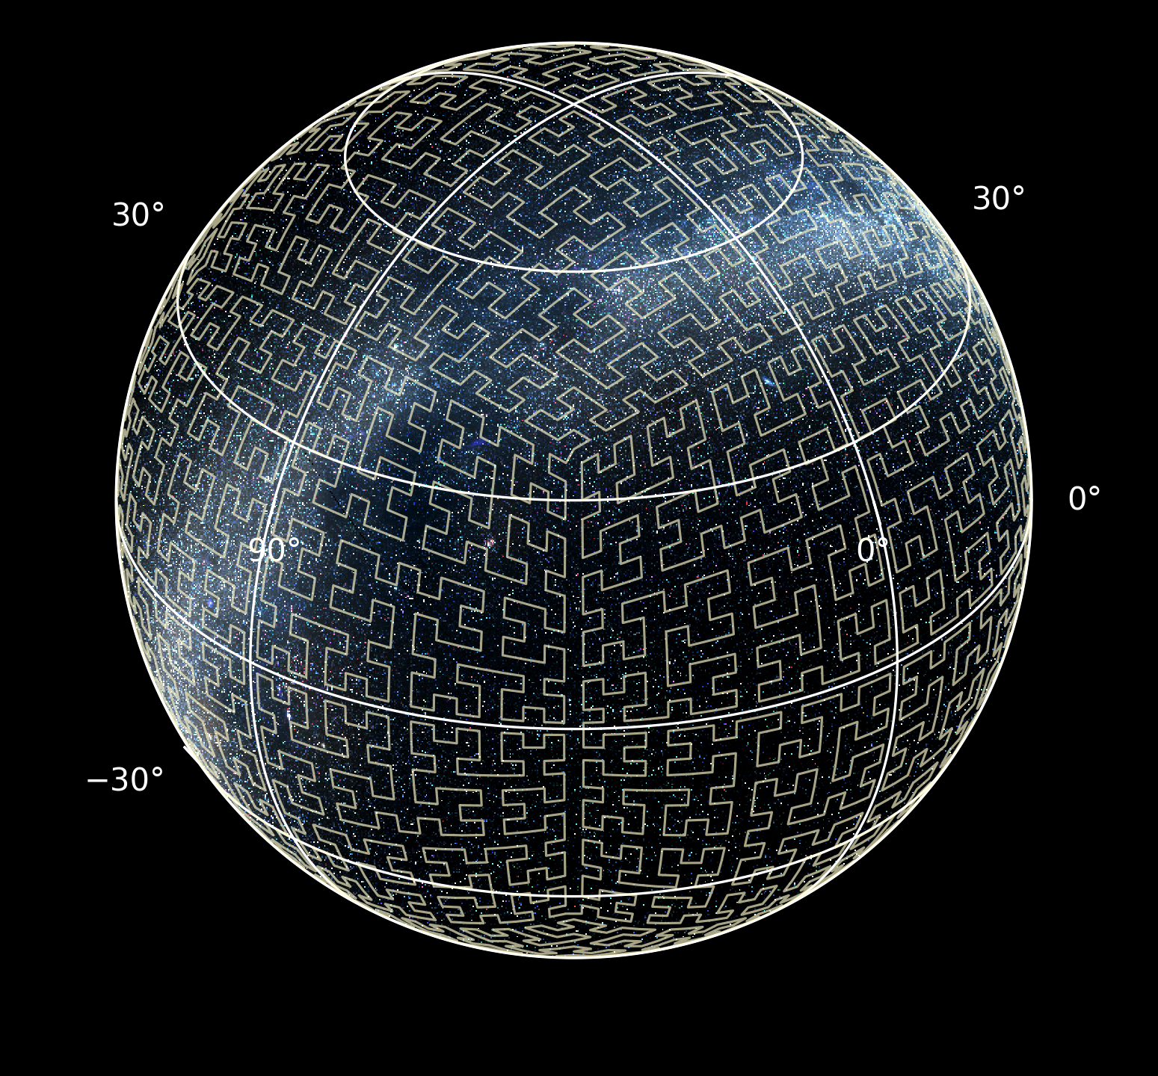
CATCH Speed improvements
Google's S2 library indexes the sky with a space-filling Hilbert curve.
http://s2geometry.io/devguide/s2cell_hierarchy
Full database searches: 38.6 M records, 12 survey sites, 29 year time span.
Target | Results | Time (s)
 |  | v3 | v4-dev
C/2001 Q4 (NEAT) | 3598 | 281 | 75
(65803) Didymos | 3161 | 472 | 209
2024 XA* | 264 | 42 | 10
M31 | 3310 | 63 | 1
* Only searched 1 year prior to impact.
S2 geometry

Slide 19
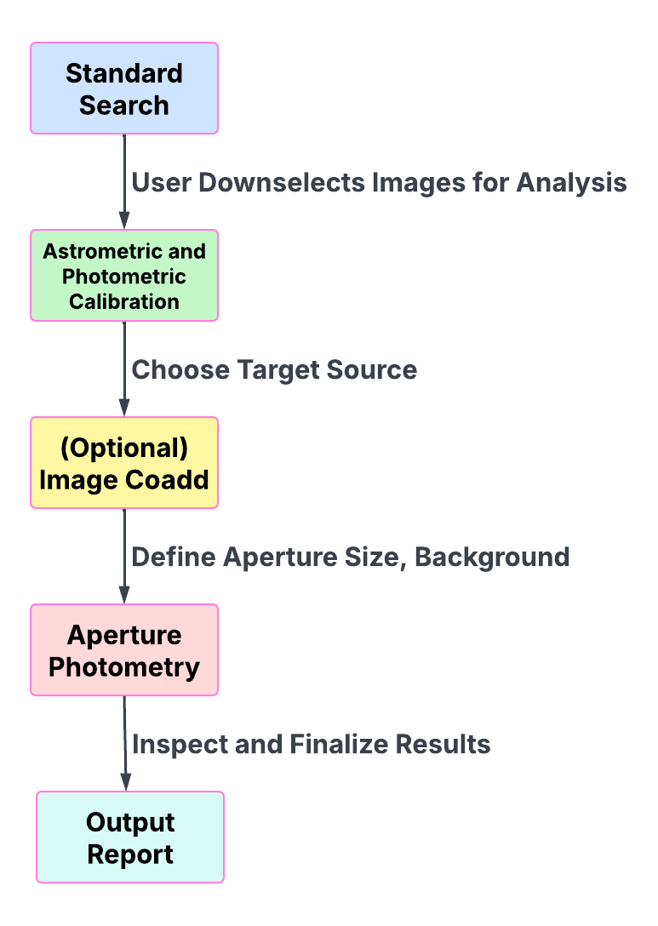
CATCH Analysis Tools
Goal: To allow a user to perform standardized photometric & astrometric analysis online.
No need to download files.
Provides direct translation of results into a draft ADES-formatted report.
Design philosophy:
Simple, direct tools
Allow user inspection of automated steps, make it easy to do the right thing

Slide 20
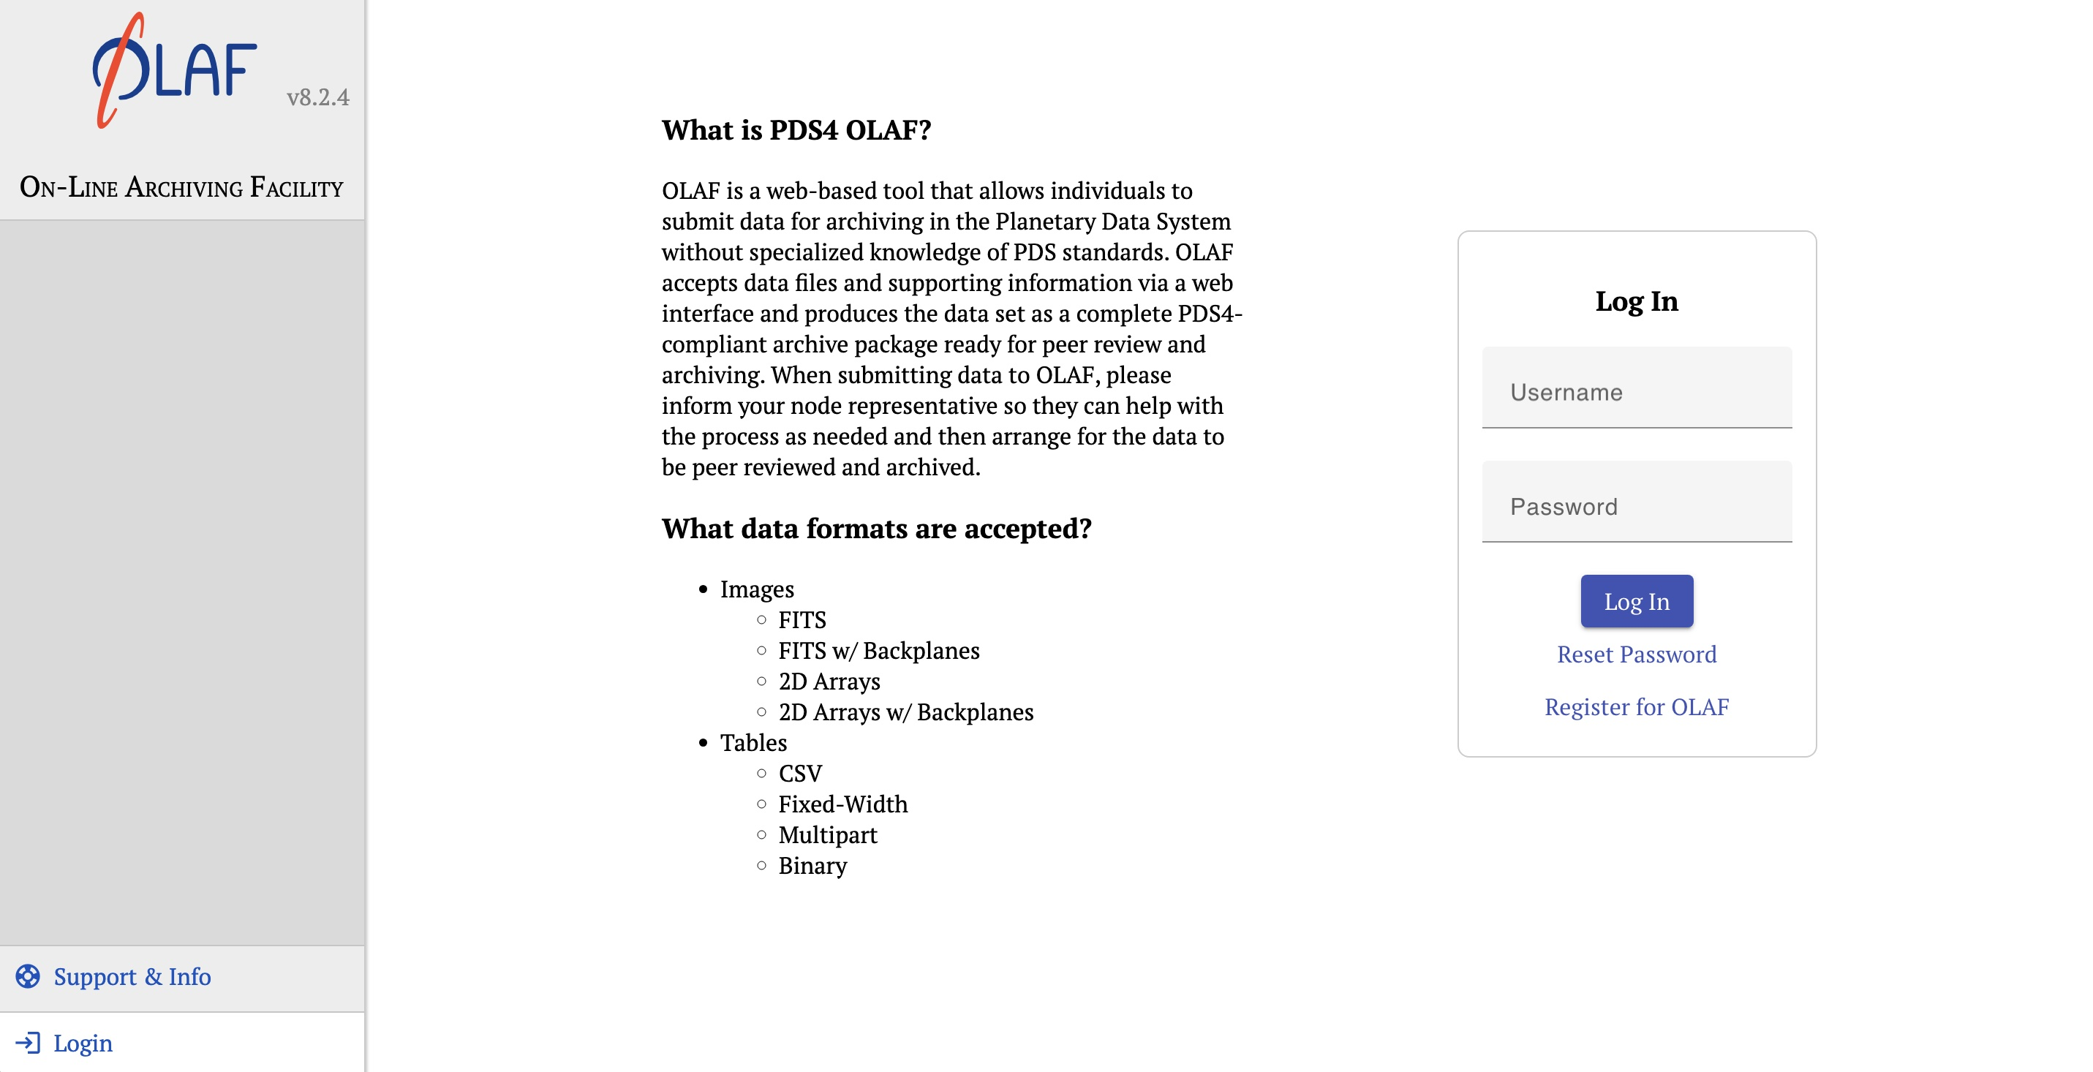
OLAF - Individual Data Providers

Slide 21
OLAF - Individual Data Providers

Slide 22
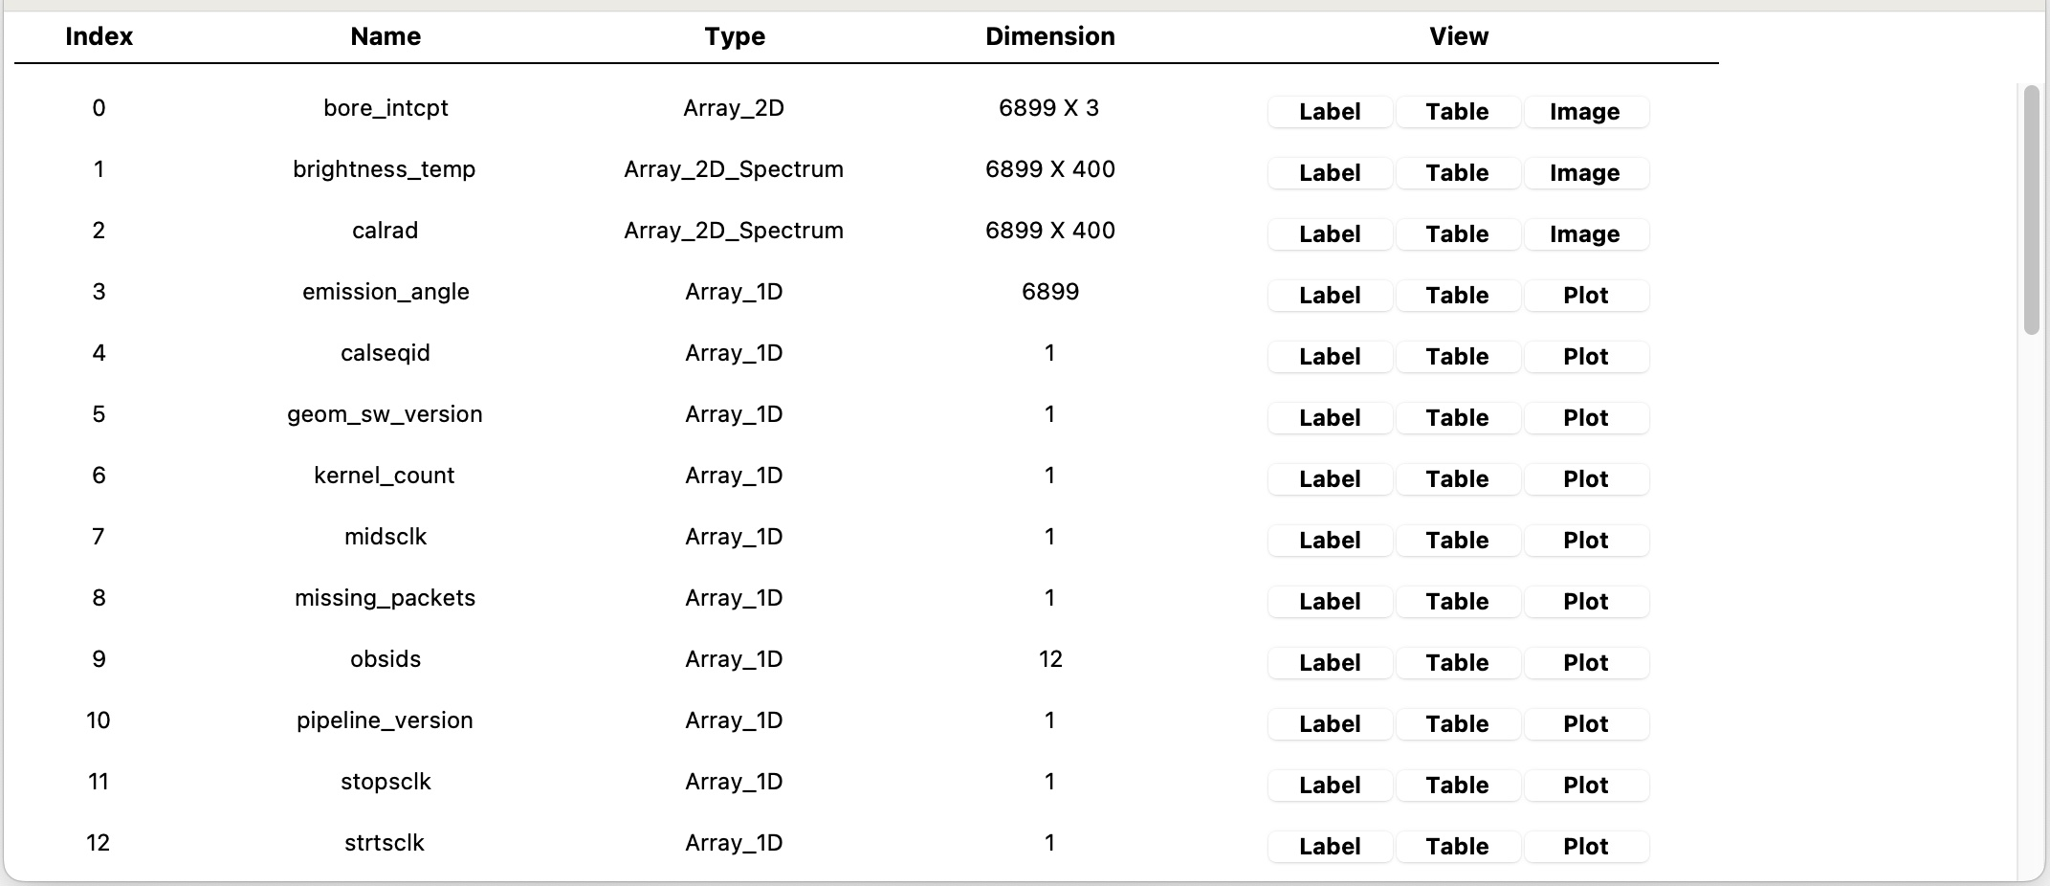
Other Services
PDS4Viewer – initiative to automate the cross-platform build process.

Slide 23
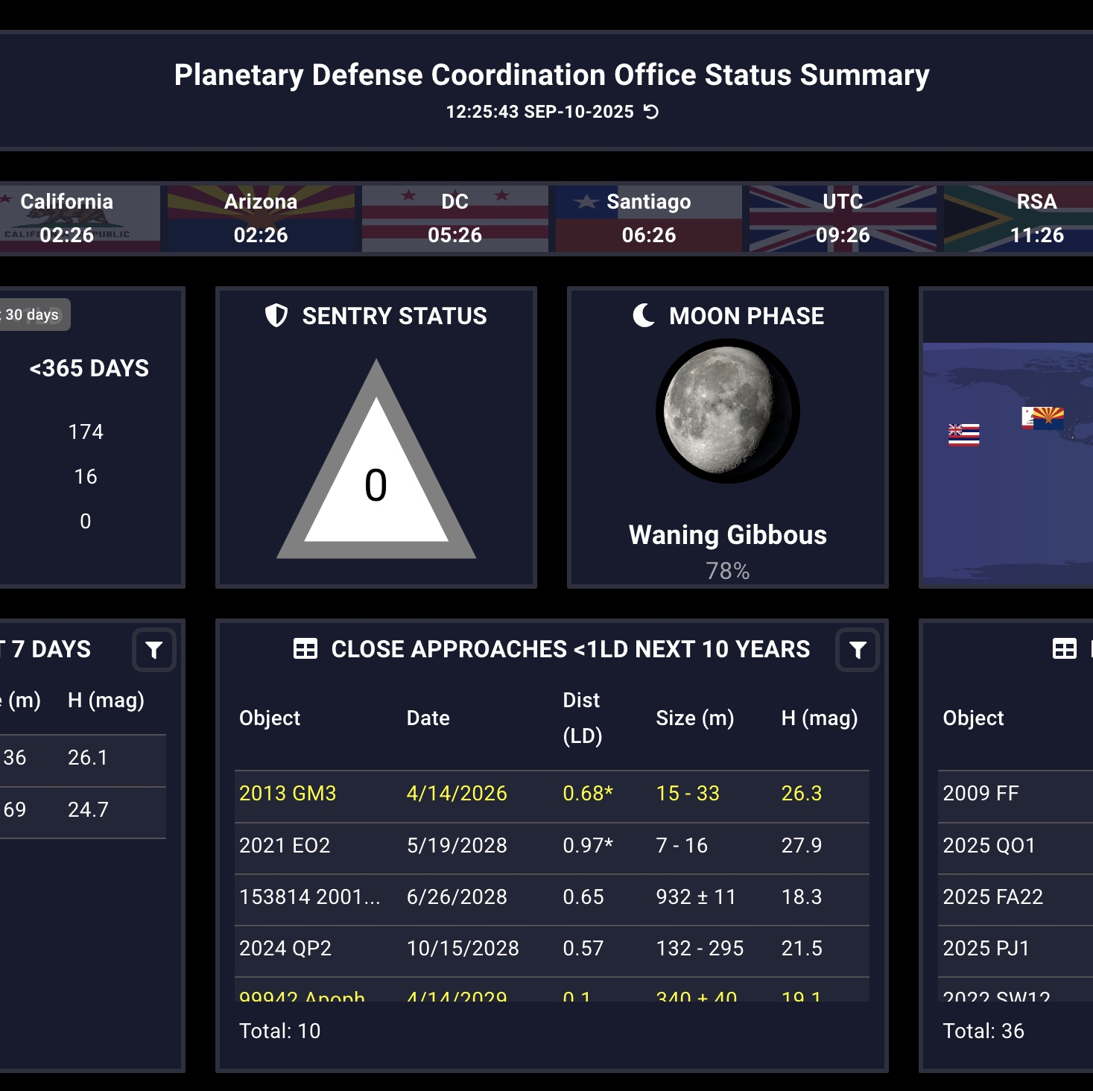
Other Activities
Support for PDS cloud initiative
Editorial WG – PDS website migration
MPC Annex
Citation Search
MPCDB Status Board
PDCO Dashboard
Participation in multiple Organizations:
IVOA, IPDA
IAWN support

Slide 24
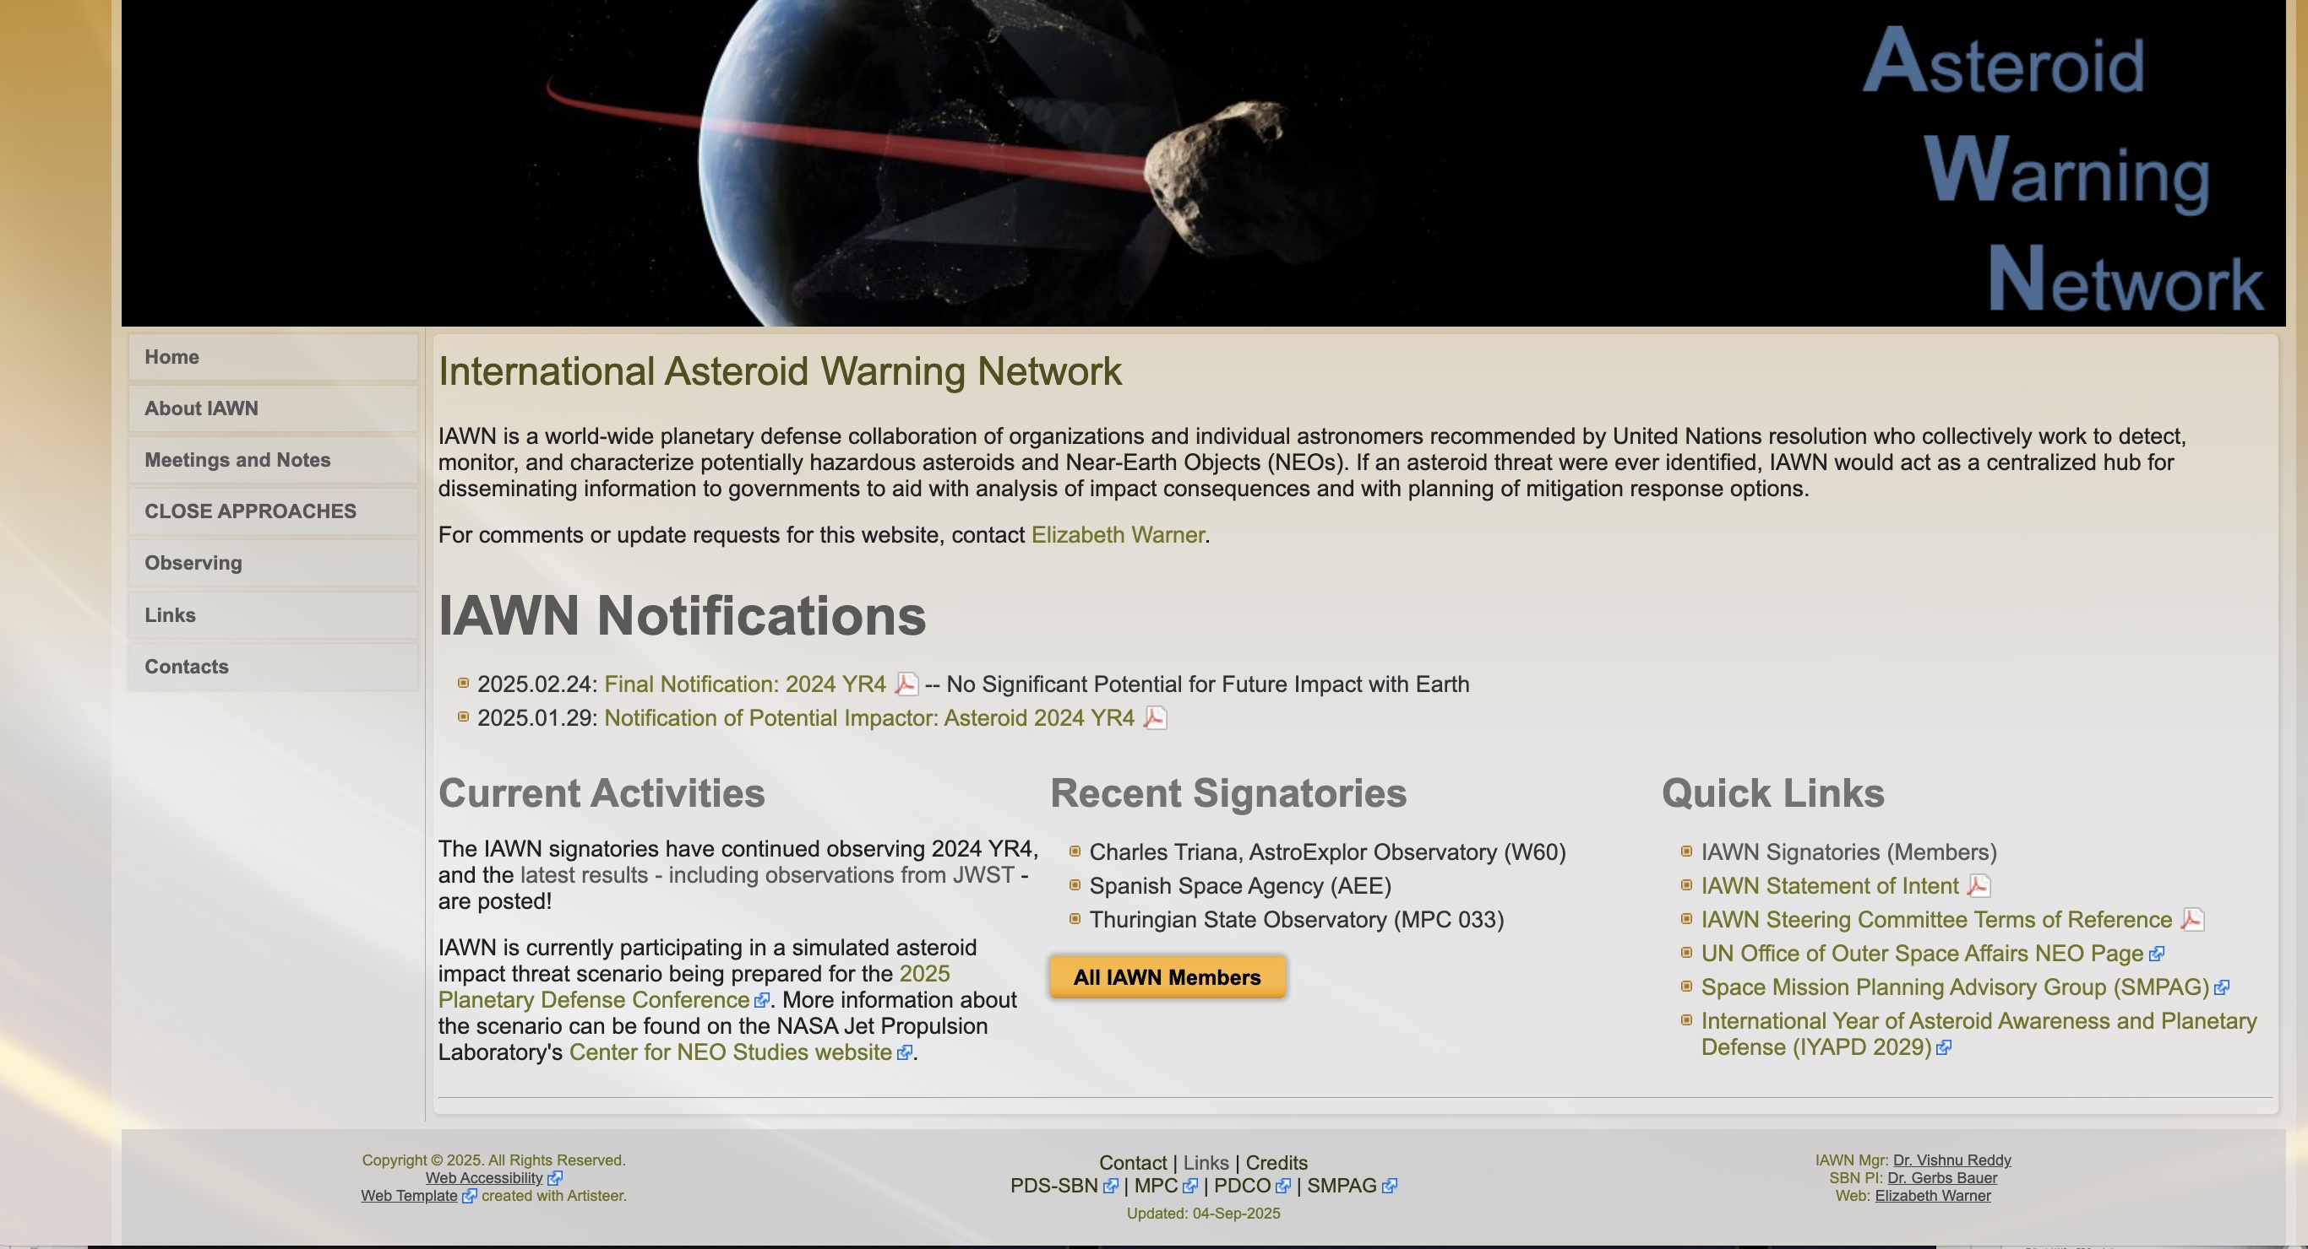
IAWN.net – website clean-up

Slide 25
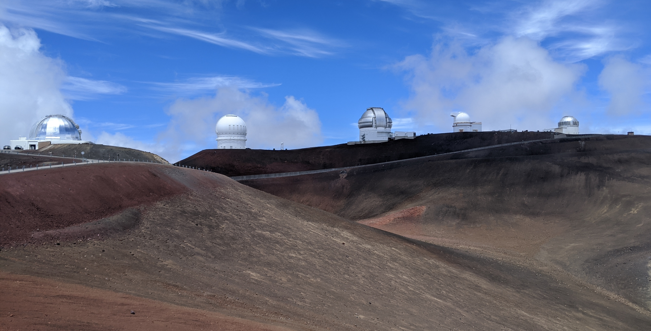
Near-Future Plans for IAWN Apophis Observing Campaigns
Dr. Cristina Thomas
J.M. Bauer, V. Reddy, D. Farnocchia, E. Warner, T. Farnham
8 September 2025
EPSC/DPS 2025 Helsinki, Finland

Slide 26
IAWN: Overview
Campaign Window | Target | Focus | Participation
March 2017-Sept. 2018 | 2012 TC4 | Astrometry, Characterization, Hazard Modeling | 69 participants from 14 countries
Feb. 2019-March. 2021 | 1999 KW4 (66391 Moshup) | Characterization, Hazard Modeling | 70+ participants from 13 countries
Oct. 2020-April 2022 | 99942 Apophis | Astrometry, Characterization, Hazard Modeling | 103 participants from 19 countries
Oct. 2021-Dec. 2021 | 2019 XS | Timing | 71 MPC Codes
Oct. 2022-Feb. 2023 | 2005 LW3 | Timing | 82 MPC Codes
March 2023 | 2023 DZ2 | Characterization | 33 participants from 12 countries
Sep. 16 – Oct. 30, 2025 | 2025 FA22 | Recovery & Characterization | 56+ participants on kick-off

Slide 27
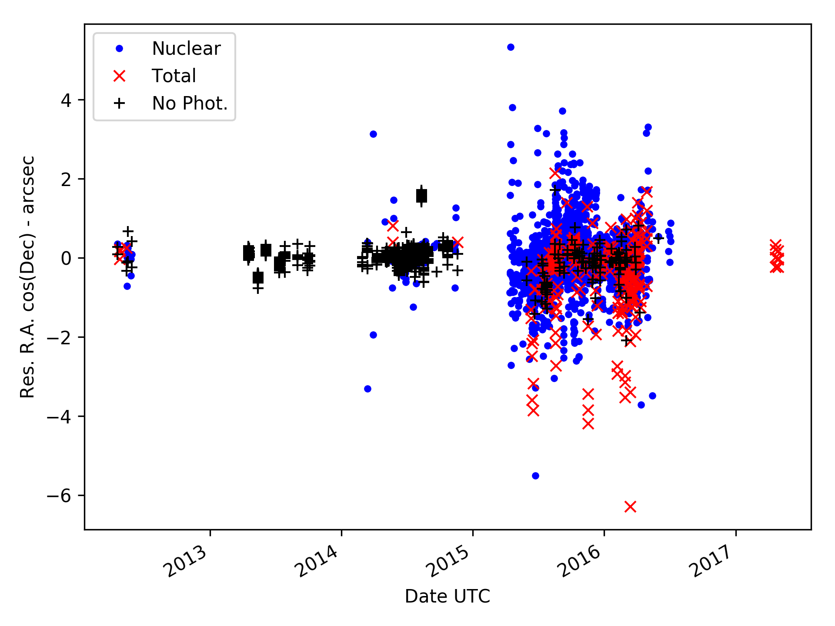
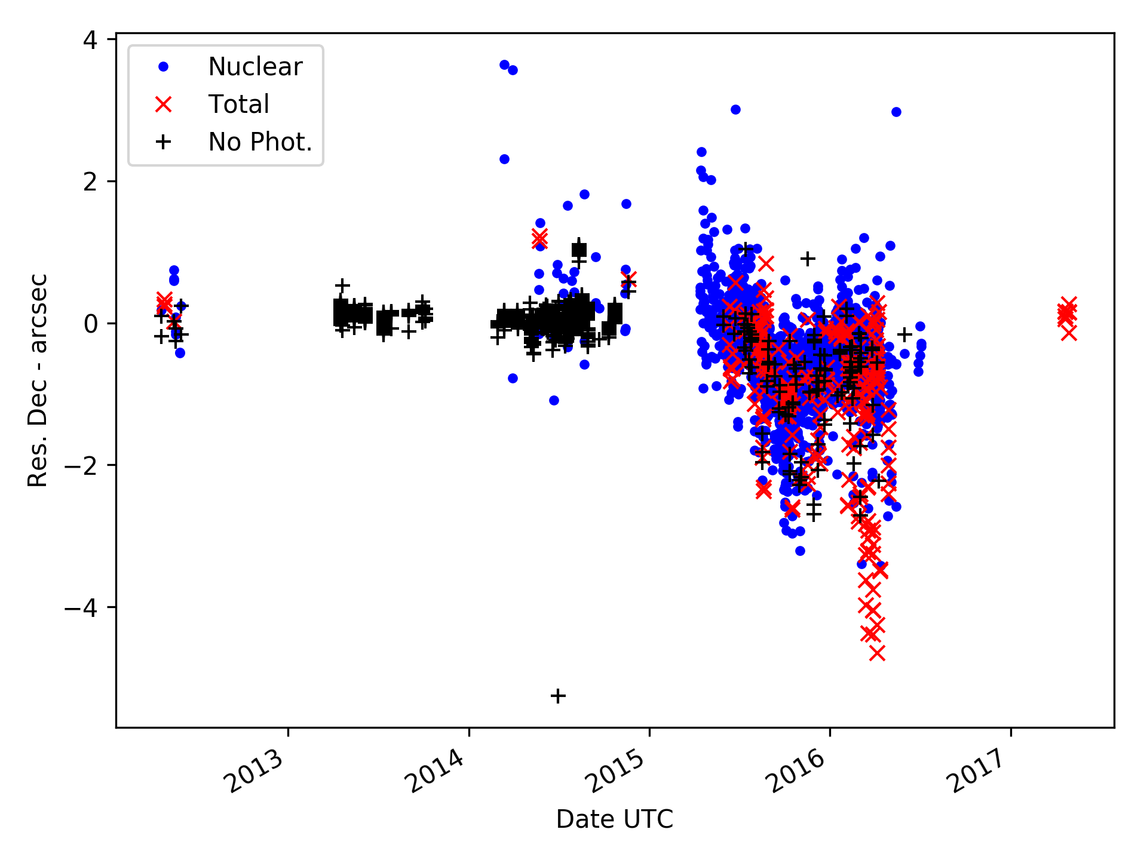
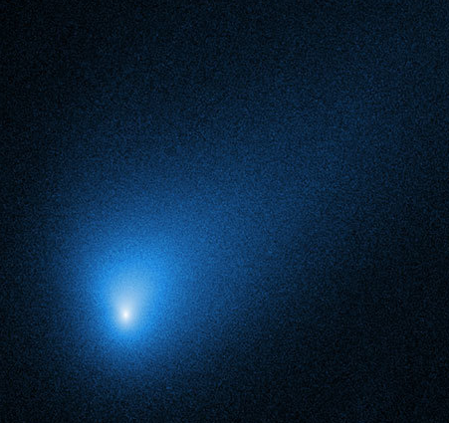
IAWN Comet Campaign
Comets are a challenge for astrometry, so we are planning on an IAWN campaign:
In Fall of 2025, we plan to hold a workshop to discuss methods to improve comet astrometry.
Later in 2025, we plan to conduct an observing campaign of a comet (if nature provides).
Comet astrometry requires good imaging resolution, to properly locate the central condensation, or “false nucleus”. Good resolution, in turns, requires good seeing. Small-scale features of the comet coma are blurred by seeing. If they are asymmetric, this shifts the centroid. Successively smaller apertures can be used to find the true brightness peak of the comet.

Slide 28
IAWN Apophis Campaign
Three opportunities to observe Apophis
2027 Apparition: 2027 February to April
2028 Apparition: 2027 December to 2028 June
2029 Apparition: 2029 January to April (Close Approach)
The organizational structure for these efforts
NASA HQ POC: Dr. Kelly Fast
IAWN Campaign Coordinator: Dr. Vishnu Reddy
Observations Working Group Lead: Dr. Cristina Thomas
*Orbit shown is pre-encounter
More Information on all IAWN Campaigns: https://iawn.net/campaigns.shtml

Slide 29
Backup Slides

Slide 30
MAQI – The MPC DB Open Query Tool

Slide 31
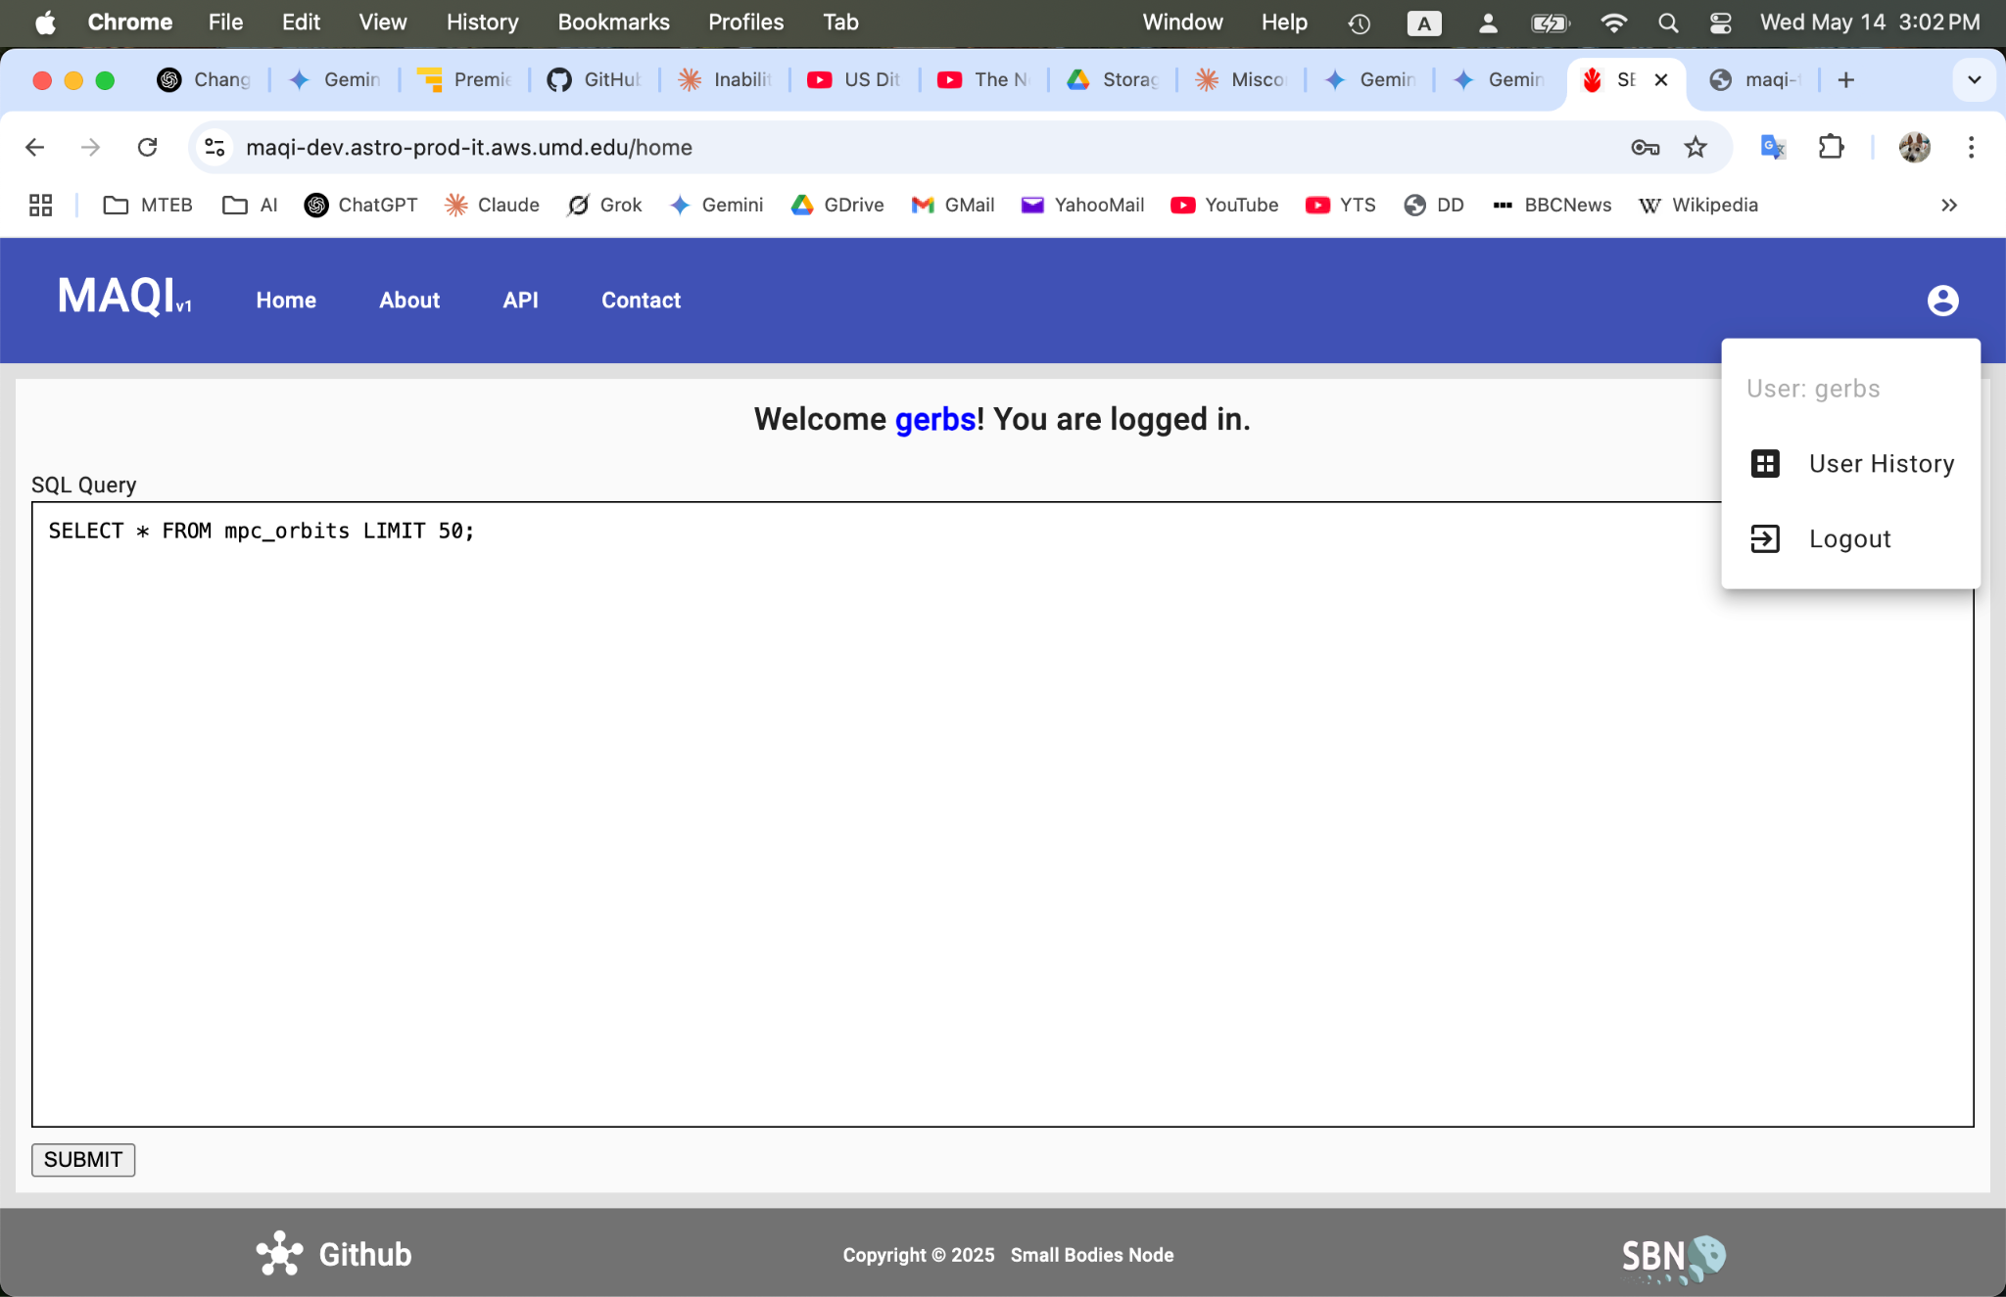
MAQI – The MPC DB Open Query Tool

Slide 32
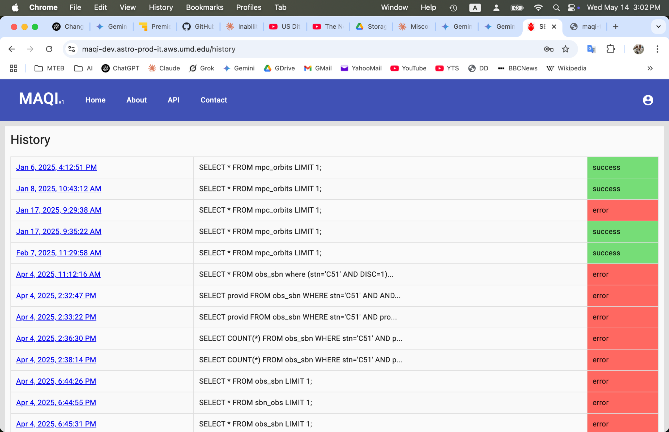
MAQI – The MPC DB Open Query Tool

